Slide 1


2023
Diocesan Services appeal
Diocese of Palm Beach

Slide 2

Welcome and prayer

Slide 3


Thank you for sharing your time with us and housekeeping items
^{Wifi: C@thedral}

Slide 4

Build relationships
Desire to collaborate and work together
Discuss updates made to best Serve the parishes
Purpose of the meeting

Slide 5
Handouts:
a. Timeline
b. Transmittal Form
c. Survey

Slide 6
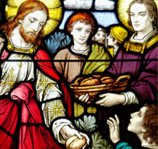
Development Team
Thank you for your grace as we have a new team
Team rules of engagement (call donors back within 24 hours, excellent customer service, cultivate a culture of philanthropy, educate donors)
Jennifer Trefelner, APR, CPRC, Director of Communications and Development
Vito Gendusa, CPA, Chief Financial Officer
Gigi Silvagnoli, Administrative Assistant
Floricela Miguel-Roblero, Donation Processing Specialist
Paige Kelly, Donation Processing Specialist
Lina Salcedo, Development Specialist

Slide 7
Introductions of attendees
Name, title, parish, years of experience in this role

Slide 8
What is the Diocesan Services appeal?
The Diocesan Services Appeal (DSA) is the annual fundraising campaign for the five-county Diocese of Palm Beach in which the faithful are asked by our Bishop to support our local church. The contribution support stretches beyond the individual parishes and funds the projects run by the diocese. The DSA reminds us that we are all part of the Catholic family and that we need to support not just our individual parishes, but our diocese as well.
https://vimeo.com/780446612

Slide 9
Recap of 2022
Goal met (but doesn’t cover all expenses of the diocese)
Regularly scheduled Zooms with DSA contacts, visits to deanery meetings, focus groups
DSA in Action Materials
More robust communication tools
Now processing gifts of any amount
Strong social media presence by diocese
Called donors who did not fulfill their pledge
Website is now updated so donors can fulfill their pledges before the start of the new year

Slide 10

2023 General Updates
New option for bilingual content
New and equal in-pew envelopes for Spanish and Creole
Redesigned in-pew envelopes
New way of updating donor profiles for all donors
New allocations of what the DSA supports
Thank you messages for parishes to use (from Bishop and beneficiaries)

Slide 11
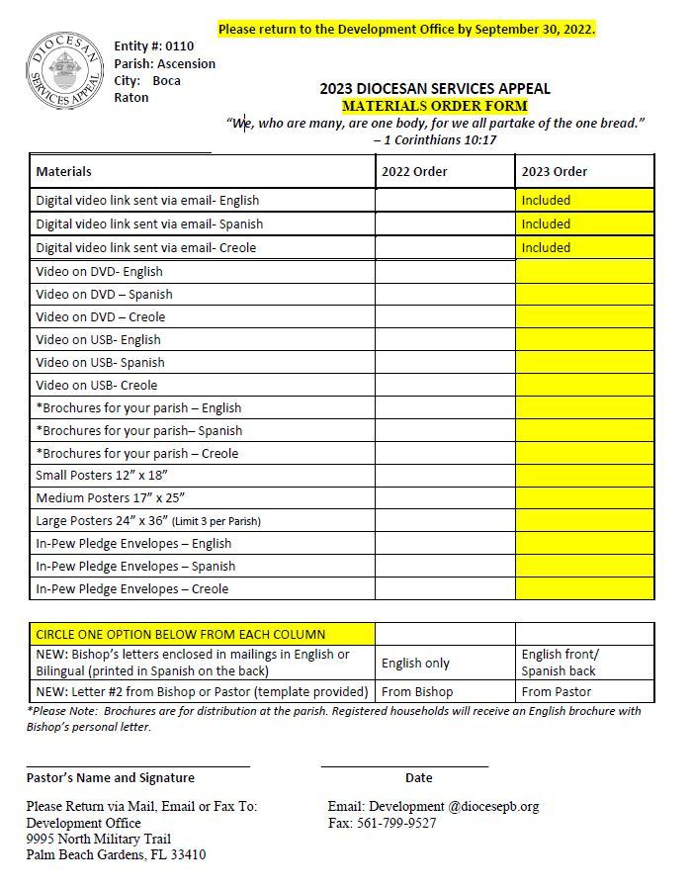
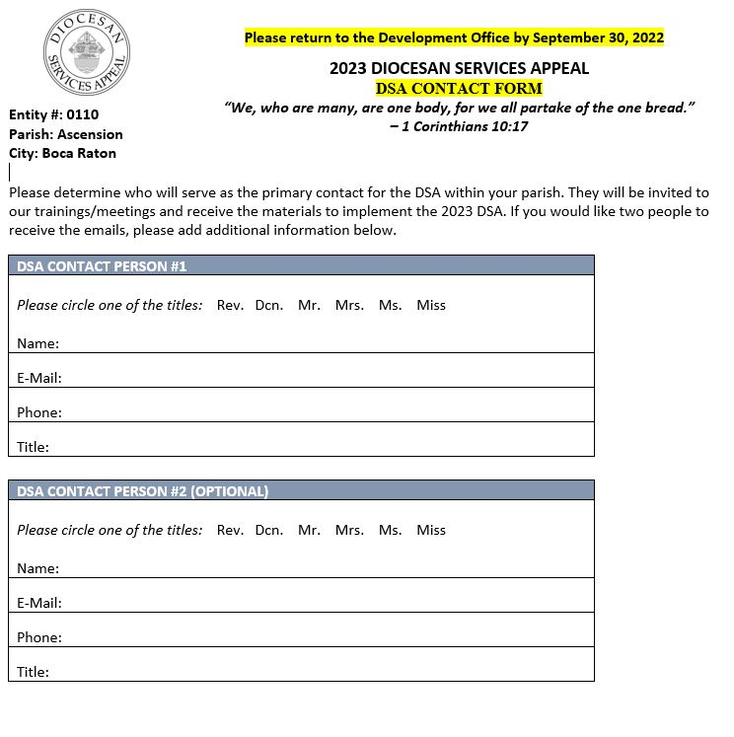

Slide 12
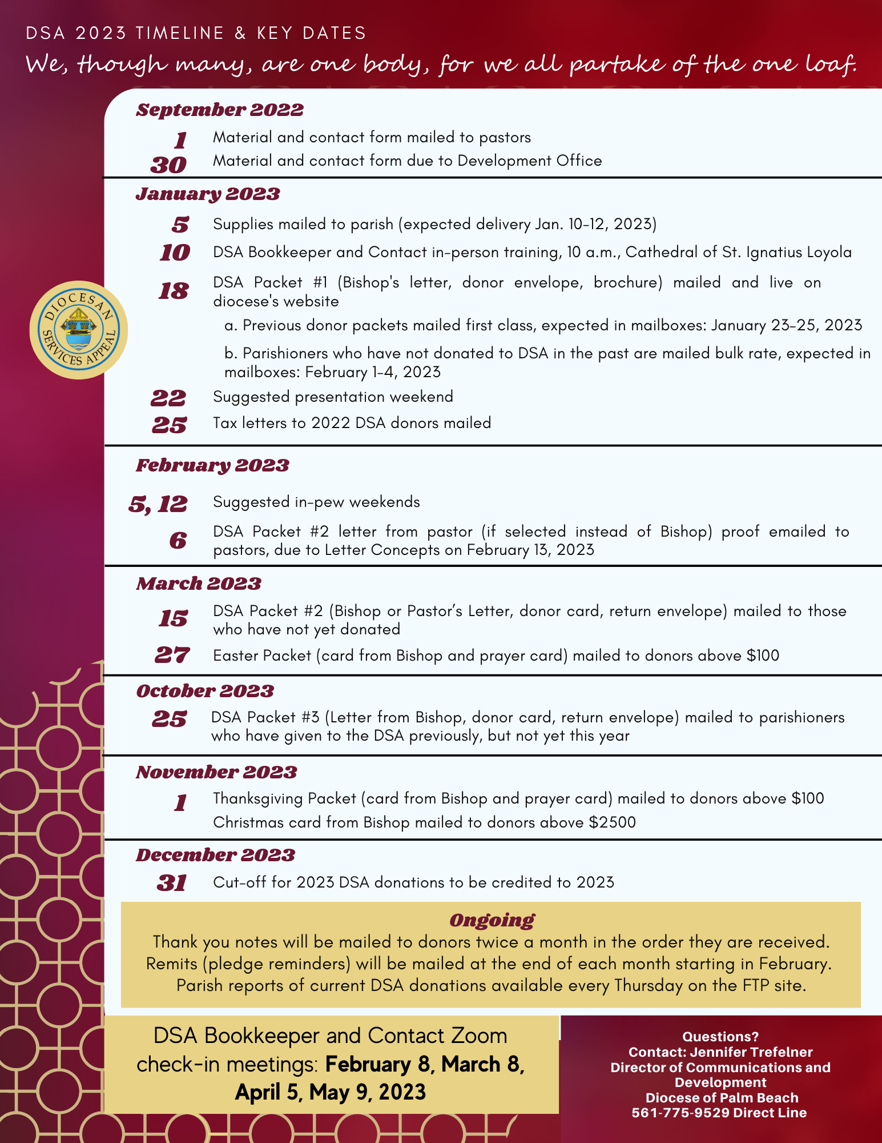

Slide 13
Social media graphics, power point slides, bulletin announcements, ambo announcements, video in three languages, vignette videos of each section, logos, QR code, poster template, Bishop’s Letters, Ambo Announcements, Bulletin Text, bulletin graphics, brochure copies, pledge graphics, thermometer template, Transmittal Form, Parishioner Contact Information Form, Data Entry Procedures for Parishes
https://www.diocesepb.org/ministriesoffices/offices/development/diocesan-services-appeal/materials.html

Slide 14
Processing gifts
Best case scenario: Donor uses card and envelope mailed to them OR
Parish deposits checks/cash and sends one check to the diocese
  Parish opens in-pew or DSA envelope
  Place donor information label on in-pew envelope
  Deposit any cash or checks (except if the check is a down payment for a credit card and Bank Authorization/Direct Debit pledge)
  Fill out Transmittal Form and email a copy of the form to Development@DiocesePB.org
  Mail check(s) via FedEx or UPS with tracking
  Check FTP site to confirm we received the check
Please send Transmittal Form and/or checks/cash to the diocese as soon as possible
If you receive cash without a name, plus use the word “Miscellaneous” as the “Donor Name” in the Transmittal Form
Please send voided check for direct debit
Please don’t deposit a check for the credit card and bank authorization
We can provide a second set of donor information labels if needed
Please do not send donors to your website to donate to the DSA, but rather the link, https://www.diocesepb.org/ministriesoffices/offices/development/diocesan-services-appeal/donate-now.html

Slide 15
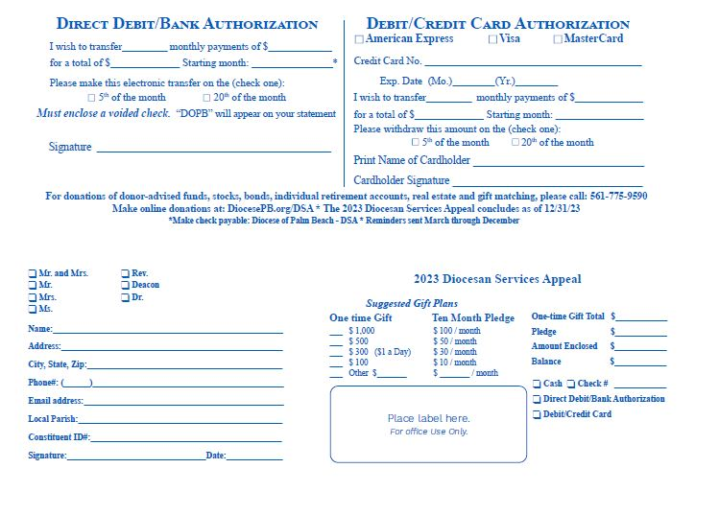

in-pew envelope (inside)
Front

Slide 16
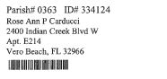
Label Template

Slide 17
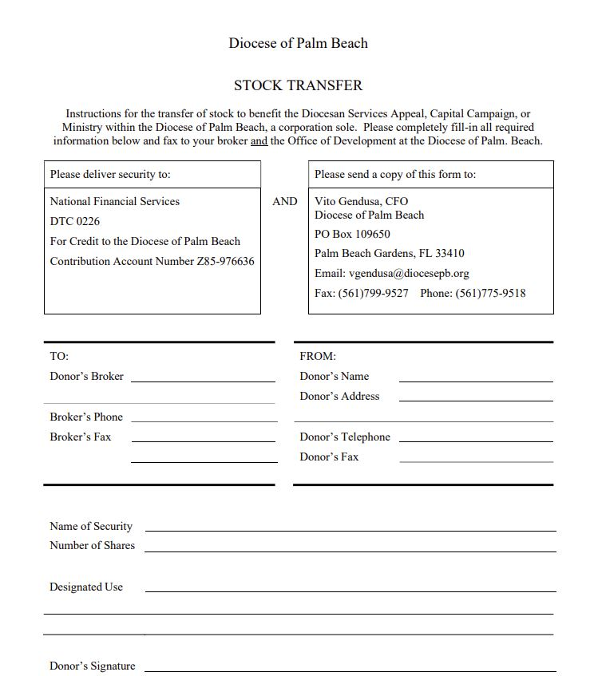
Stock transfer form

Slide 18
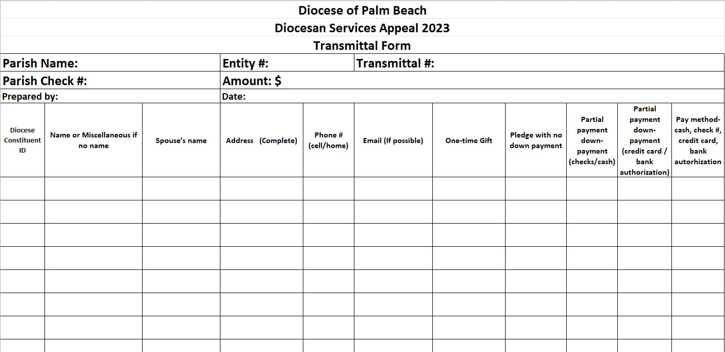
Transmittal form template

Slide 19
FTP Site
New system for sharing donor contact/new parishioners (for parish to diocese and diocese to parish)
Pastor to contact the diocese of who has access and who should have access to the development folder
For 2023, Friday reports now available on Thursday
Please ensure someone at your parish can check the FTP, so we do not have to email the reports separately

Slide 20
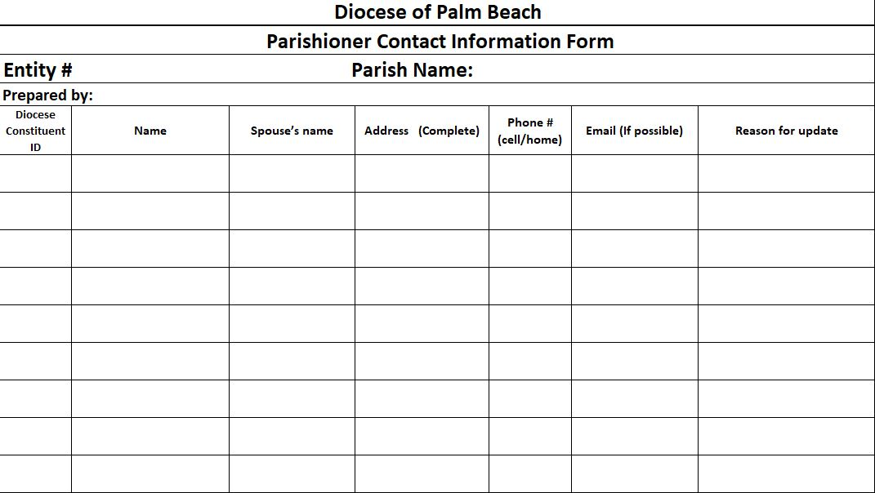
Parishioner contact information form for the ftp

Slide 21
Thank you process for parishes:
No need for parishes to send thank you notes for DSA donations
Donations more than $2,500 are signed by the Bishop
Thank you notes are sent every other Friday once they are processed

Slide 22
Tax Letters for DSA Donations
Parishes do not need to send the tax letters
The diocese will send them in January 2023 for 2022 gifts

Slide 23
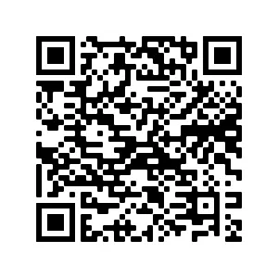
Digital Tools
Please add a link the DSA on your parish’s website
You can also use the QR code on all materials
You can share the diocese’s social media posts promoting the DSA

Slide 24
How donors can give
Please make checks payable to Diocese of Palm Beach- DSA
Donation envelope mailed to parishioner’s home
In-pew envelope at your parish
Online at www.DiocesePB.org
Gifts of donor-advised funds/stocks (please use form)/bonds/individual retirement accounts/real estate
Check with your employer for gift matching opportunities
Gifts and pledges can be made using cash, check, credit card, debit card, direct debit/bank authorization, money order/cashier’s check

Slide 25
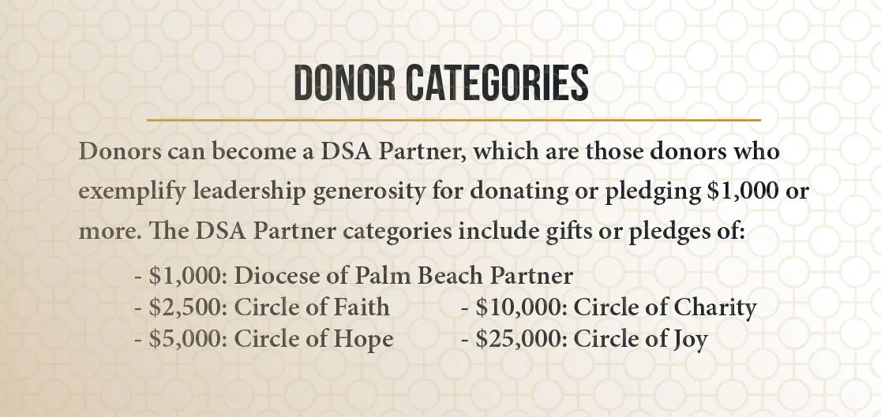

Slide 26
How the diocese thanks donors
Thank you note ($2,500 and up signed by Bishop)
New option for Florida Catholic in print once an month and/or digital version once a week
Easter Packet (card from Bishop and prayer card) mailed to donors above $100 mailed: March 27, 2023
Easter phone call (any donor for past calendar year)
Thanksgiving Packet (card from Bishop and prayer card) mailed to donors above $100 mailed: October 31, 2023
Christmas phone call (any donor from past calendar year)

Slide 27
Future plans for development in 2023
Provide IRA distribution resources
Employee payroll deduction program
Create planned giving/wills/trusts/estate planning resources

Slide 28
Thank you!
Please complete the survey before leaving
We are happy to answer any questions you may have
Blessings to you and your parish now and always
Closing prayer

Slide 29
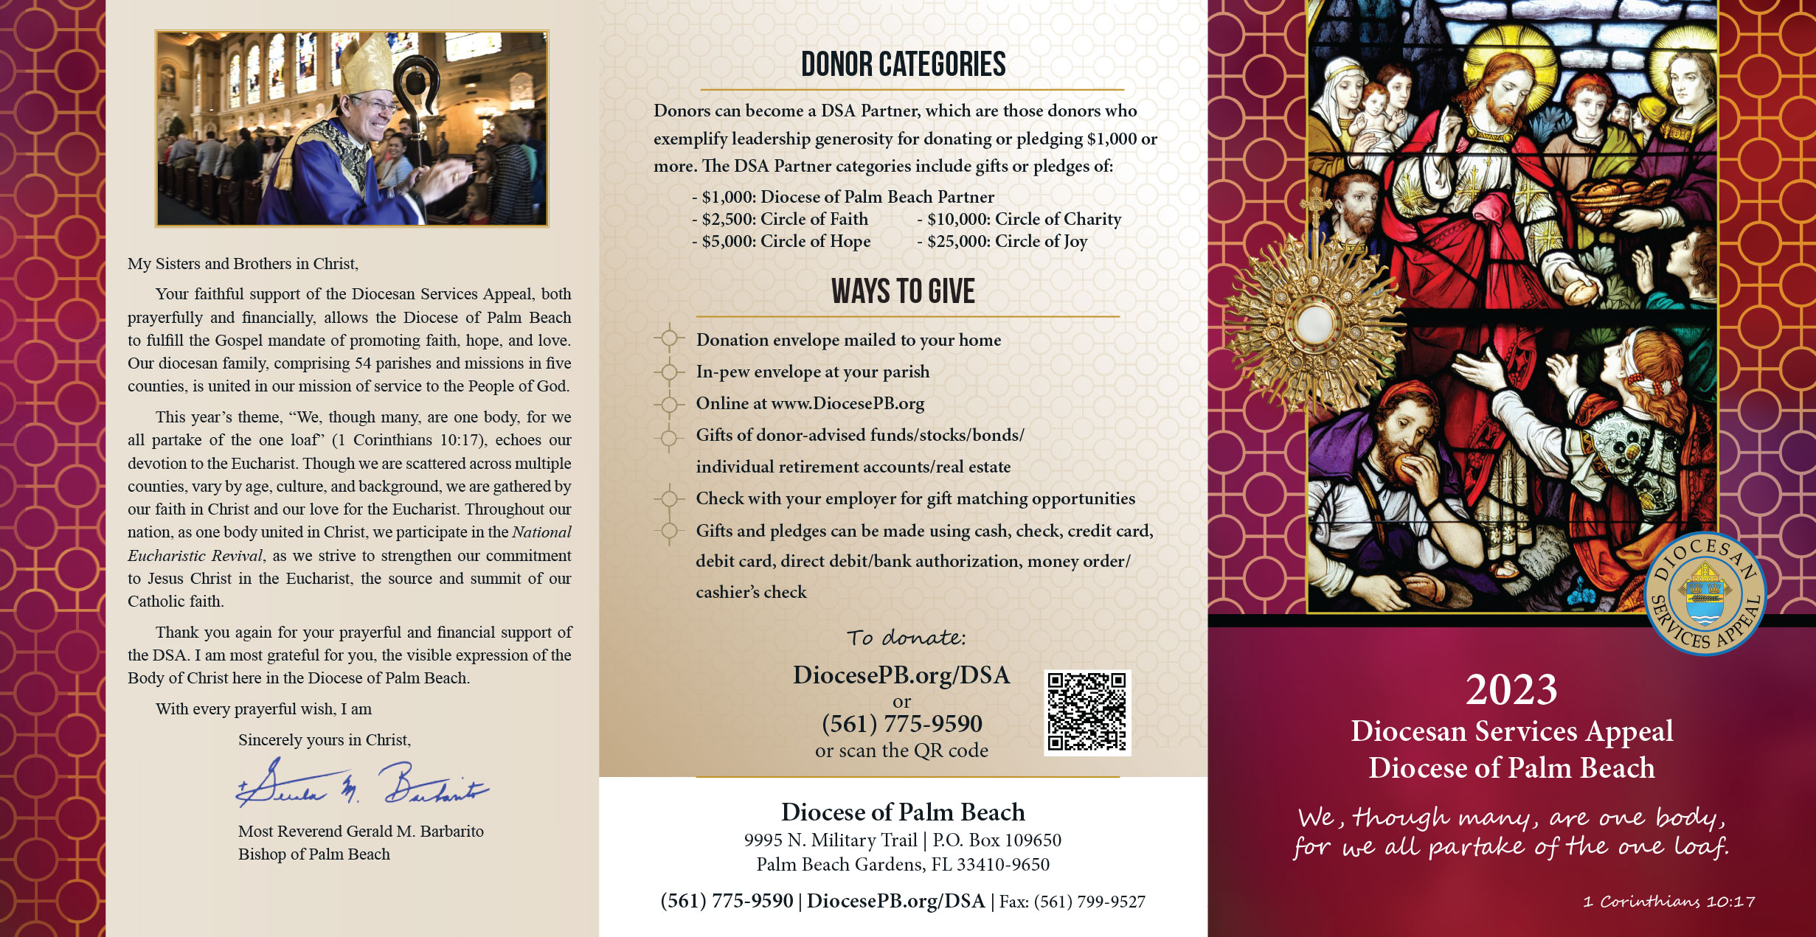

Slide 30
