Slide 1
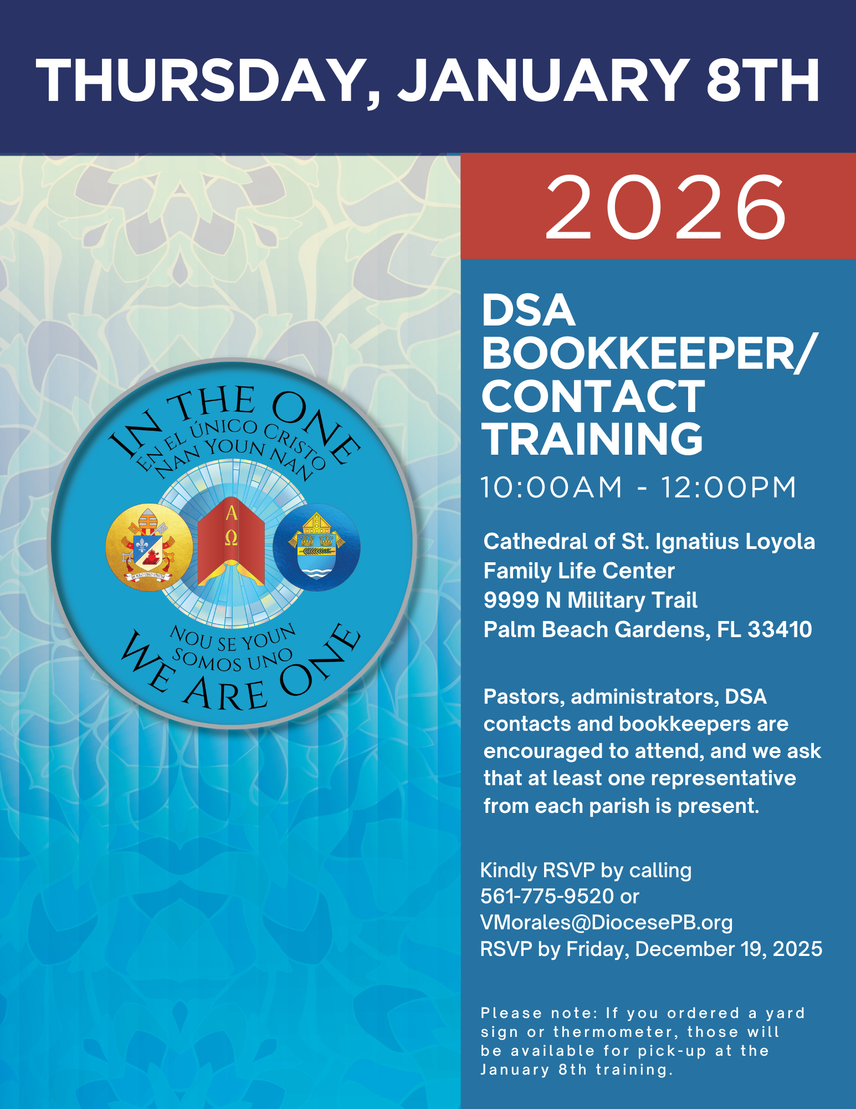

Welcome!
2026
Diocesan Services
appeal

Slide 2
Welcome and Prayer

Slide 3

Thank you for sharing your time with us and housekeeping items
^{Wifi: C@thedral}

Slide 4
Build relationships
Desire to collaborate and work together
Discuss updates made to best Serve the parishes
PURPOSE OF THE MEETING

Slide 5
a. Timeline b. Transmittal Form c. Survey
HANDOUTS

Slide 6
OFFICE OF DEVELOPMENT
Team rules of engagement (call donors back within 24 hours, excellent customer service, cultivate a culture of philanthropy, educate donors)
Jennifer Trefelner APR, CPRC,
Director of Communications and Development
Vito Gendusa,
CFO
Diocese of Palm Beach
Merlys Bolduc,
Development and Lumen Christi Coordinator
Floricela Miguel-Roblero, Donation Processing Specialist
(Online Donations, Credit Cards, Direct Debit / Bank Authorization, AUTO CHECKS)
Paige Kelly,
Donation Processing Specialist
(Cash and Checks)
Lina Salcedo,
Development Specialist (Stocks / Securities, Matching Gifts Foundations, Charitable Trusts, Tax letter, acknowledgments, etc.)
Viviana Morales,
Development Specialist (Transmittals, REPORTS, Parish/Parishioner Relations)
Val Cronin,
Data Entry Clerk
(Seasonal DSA Support)

Slide 7
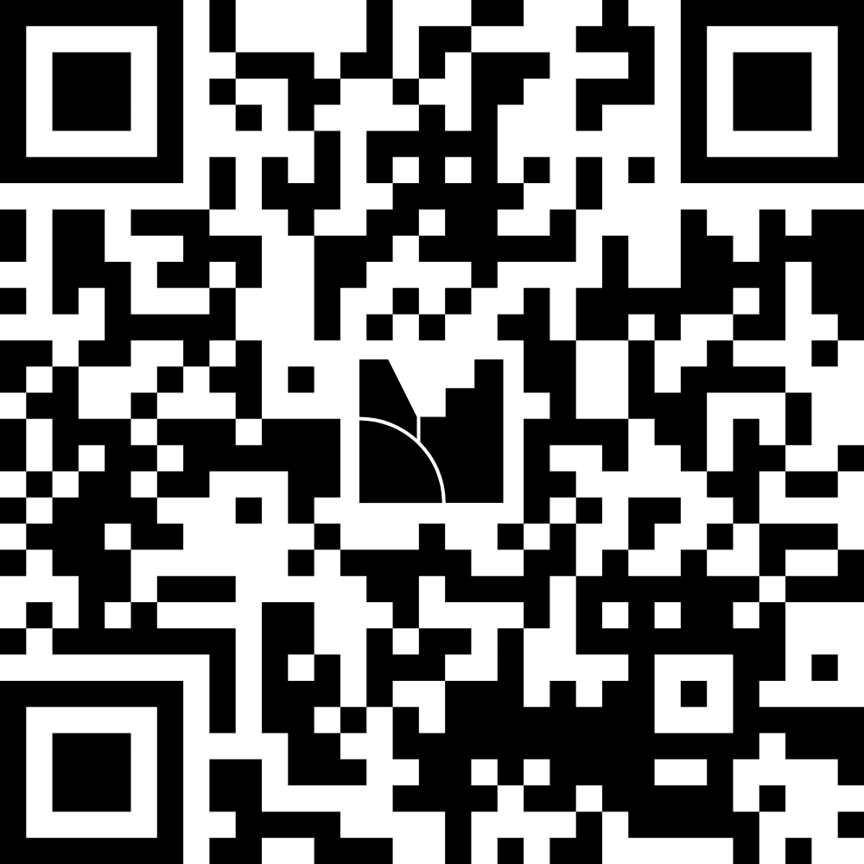
MENTIMETER

Slide 8
Introductions of attendees
Name, title, parish,
years of experience in this role, best way you promote the DSA in your parish

Slide 9
What is the Diocesan
services appeal?
The Diocesan Services Appeal (DSA) is the annual fundraising campaign for the five-county Diocese of Palm Beach in which the faithful are asked by our Bishop to support our local church. The contribution support stretches beyond the individual parishes and funds the projects run by the diocese. The DSA reminds us that we are all part of the Catholic family and that we need to support not just our individual parishes, but our diocese as well.

Slide 10
UPDATES MADE IN RECENT YEARS
Goal met (but doesn’t cover all expenses of the diocese)
Emailing September packet instead of snail mail (material order forms, DSA contact form)
Regularly scheduled Zooms with DSA contacts
More robust communication tools
Bilingual content for videos, letters and donor cards
Florida Catholic digital and print piece as perk for donors
Utilizing Florida Catholic Raiser’s Edge email database to ask for donations
Planned giving letter in tax letter
DVD’s and USB’s have (Spanish, Creole, English) versions of the DSA video
FTP site now has material order form, contact form and goal form (Finance Folder)
New format for us sharing parishioner updates with uploaded updates to FTP site each month
  Parishes send us their updates each month using the Parishioner Contact Information Form
Buck slip for constituents with multiple parishes
Must have parish email to have access to FTP
  IT will work with parish to establish proper email when necessary

Slide 11
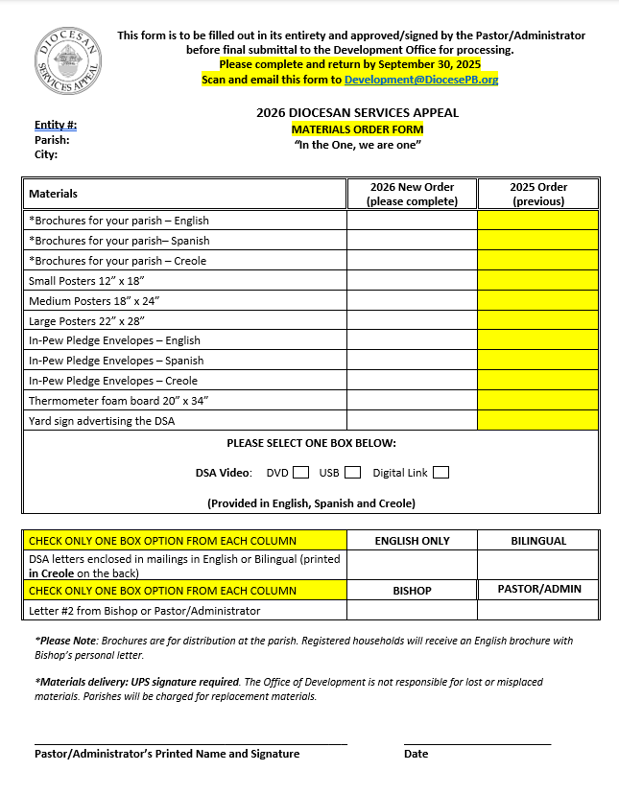
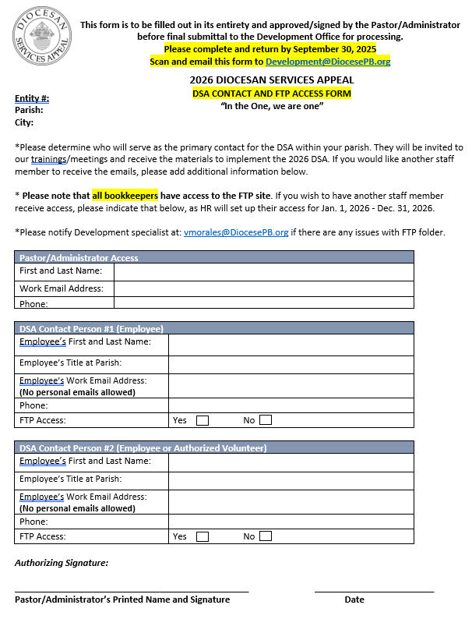

Slide 12
2026 UPDATES
REDESIGNED IN-PEW ENVELOPES
NO LABELS PRINTED
UPDATED VERSION OF TRANSMITTAL FORM
UPDATED TIMELINE TO ALLOW FOR EASTER CARD BEFORE LETTER#2
PASTORS/ADMINISTRATORS ALSO HAVE ACCESS TO FTP (IN ADDITION TO APPROVED CONTACTS AND ALL BOOKKEEPERS)

Slide 13
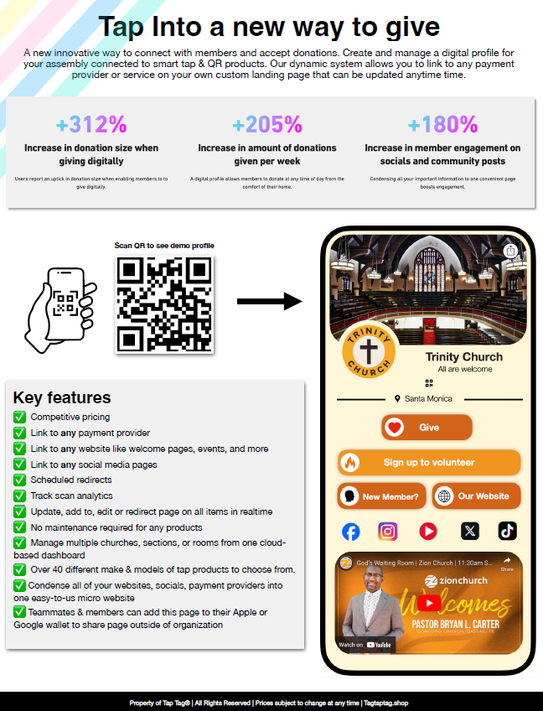
TAP TO GIVE
Take your parish donations to the next level!
Order directly from TapTag
No contracts, Cancel any time

Slide 14
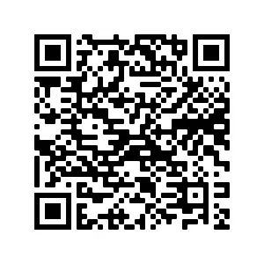
DIGITAL TOOLS
Please add a link the DSA on your parish’s website
You can also use the QR code on all materials
You can share the diocese’s social media posts promoting the DSA

Slide 15
Social media graphics, power point slides, bulletin announcements, ambo announcements, video in three languages, vignette videos of each section, logos, QR code, poster template, Bishop’s Letters, Ambo Announcements, Bulletin Text, bulletin graphics, brochure copies, pledge graphics, thermometer template, Transmittal Form, Parishioner Contact Information Form, Data Entry Procedures for Parishes
https://www.diocesepb.org/ministriesoffices/offices/development/diocesan-services-appeal/materials.html

Slide 16
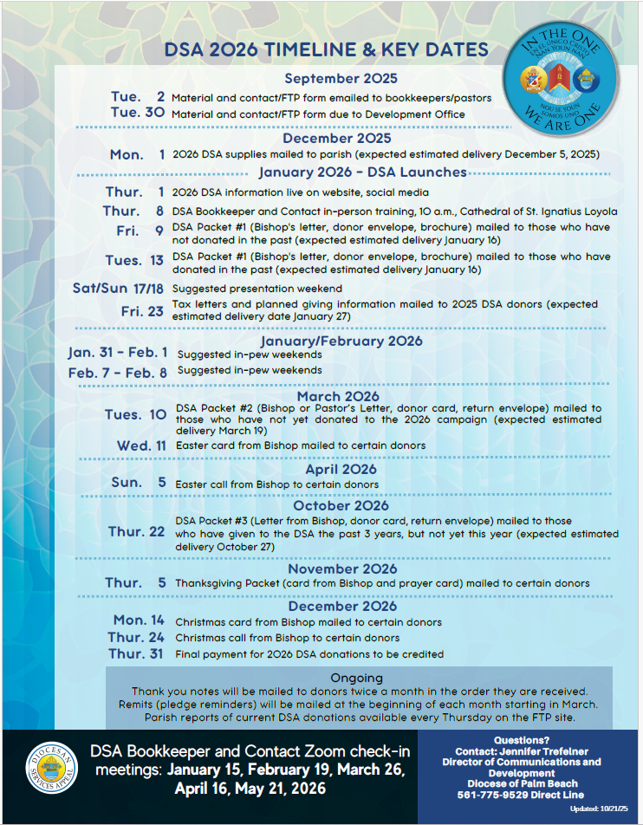

Slide 17
Ways to give

Slide 18
How donors can give
  DSA appeal packet mailed to donor’s home
  In-pew envelope at the parish
  Online at www.DiocesePB.org
  Gifts of donor-advised funds/stocks (please use form)/bonds/individual retirement accounts/real estate
  Employer gift matching opportunities
  Gifts/pledges using cash, check, credit card, debit card, direct debit/bank authorization, money order/cashier’s check
  Checks can be payable to Diocese of Palm Beach- “DSA”

Slide 19
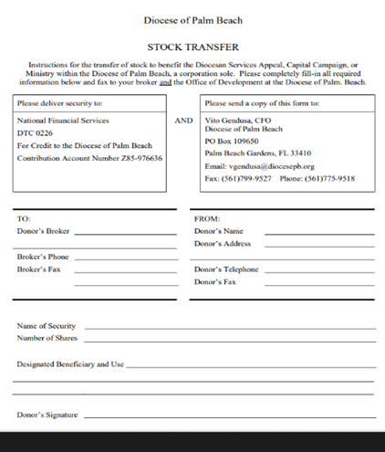
Bookkeeper to give form to the donor to fill out
Broker returns complete form directly to DoPB following instructions on form
Stocks Gifts

Slide 20
donor categories
  Donors can become a DSA Partner, which are those donors who exemplify leadership generosity for donating or pledging $1,000 or more. The DSA Partner categories include gifts or pledges of:
  $25,000: Circle of Joy
  $10,000: Circle of Charity
  $5,000: Circle of Hope
  $2,500: Circle of Faith
  $1,000: Diocese of Palm Beach Partner

Slide 21
How the diocese thanks donors
Thank you notes sent every two weeks ($2,500 and up signed by Bishop)
Option for Florida Catholic in print once a month and/or digital version once a week
Easter card (card from Bishop and prayer card) mailed to donors above $1,000
Thanksgiving card (card from Bishop and prayer card) mailed to donors above $100
Christmas card from Bishop (donors above $2,500)
Phone holiday messaging:
  Easter phone call from Bishop(any number in RE)
  Christmas call from Bishop (any number in RE)
No need for parishes to send thank you notes for DSA donations if DoPB receives notification of donation

Slide 22
office of development
INSTRUCTIONAL BREAKDOWN OF PARISH FOR
FTP ACCESS, PLEDGE CARDS, IN-PEWS ENVELOPES, TRANSMITTALS AND PARISHIONER UPDATES​

Slide 23
FTP SITE
Must have DPB or parish email to access FTP site
Every Pastor and bookkeeper has access to the FTP site, plus those the Pastor listed on the September mailing form
Weekly reports available on Thursday
Contact and material forms are available on FTP
Visit FTP site to see reports, folders, etc.
Rosters posted in January and October for parishes to verify data

Slide 24
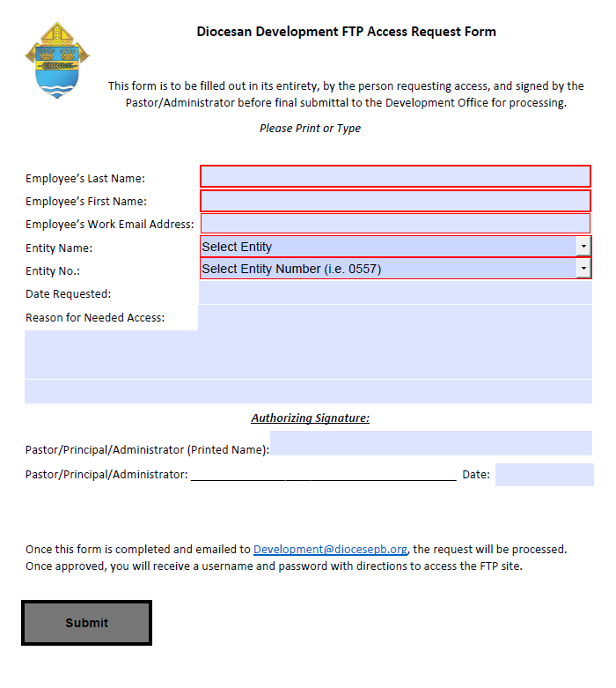
To get access to the ftp site after January

Slide 25
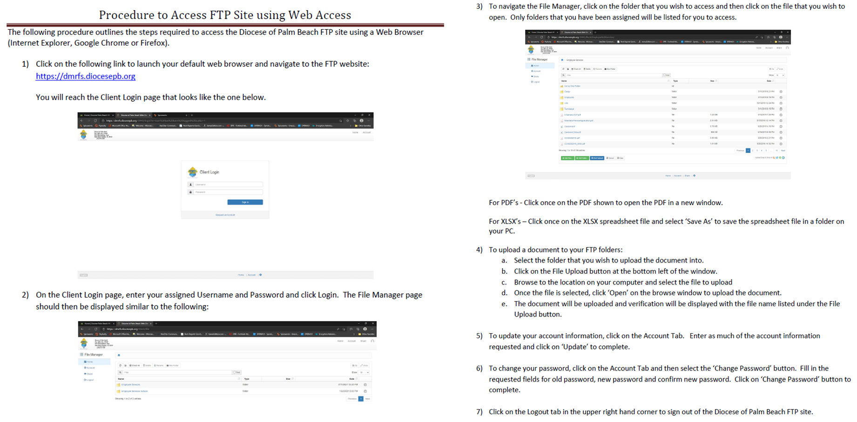
FTP access instructions

Slide 26
Pledge Cards &
In-pew Envelopes

Slide 27
Pledge cards
Pledge cards are mailed to parishioners who are registered within our diocesan database who have been active in the last seven years, either with a corresponding parish code or as a non-parishioner.
They are personalized with the name, ID number, parish affiliation, and address of the parishioner.
Parishioners can indicate their gift in varying fields provided on the card.
The card has a front and a back:
  Front: Cash, Check, QR Code for Online Giving
    also includes personalized recommendations for giving based on previous history
  Back: Credit Card and Direct Debit / Bank Authorization
A space for corrections is provided as well as additional information, such as email, phone number, and birthday.

Slide 28
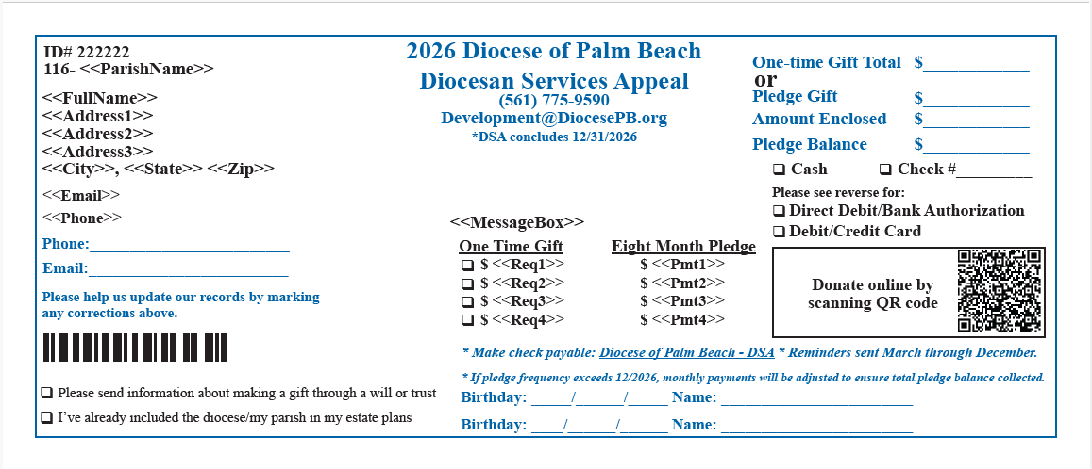
Pledge cards (front)

Slide 29
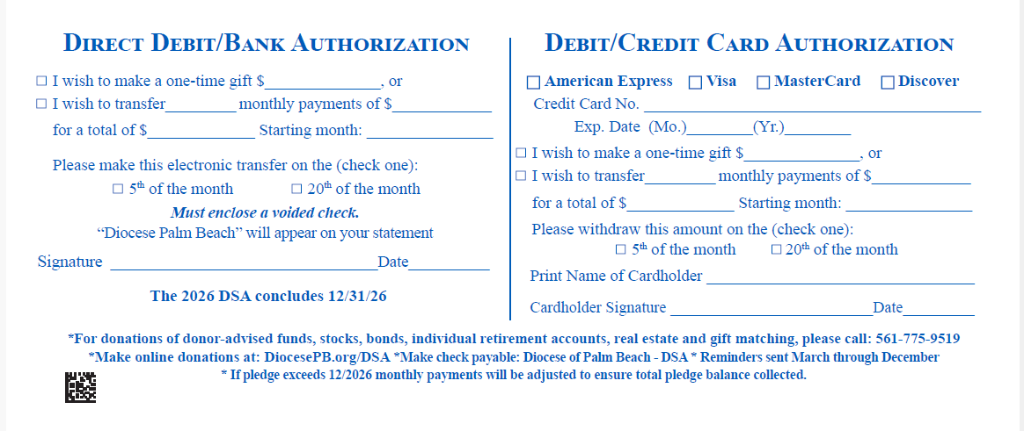
Pledge cards (back)

Slide 30


Marking the cards
DO’S AND DONT’S
When you receive pledge cards and in-pew envelopes, it is important that you follow a simple verification process to account for gifts that are included or to notate when there is a discrepancy between the information on the card and the gift included.
An easy way to do this is to simply check the amount enclosed and the gift type with a red pen.
  For checks, please verify or correct the check number when notating.
  Sometimes parishioners forget to enclose the gift. If this is the case, please contact your parishioner to inform them there was nothing enclosed when you received their gift.

Slide 31

DO’S
300.00
1333

Slide 32

DONT’S
Copy of check is taped to back of card for records when changes are made
300.00
1333
3215

Slide 33
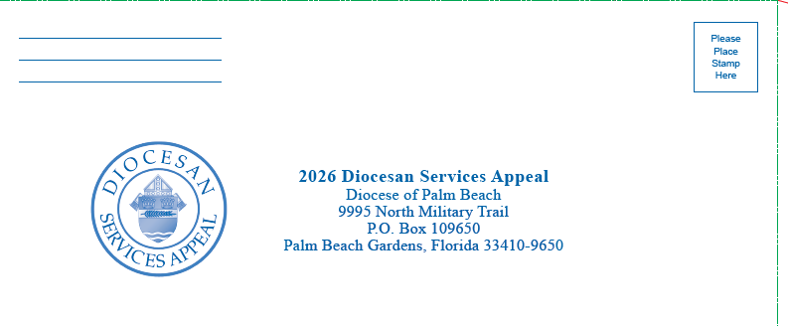
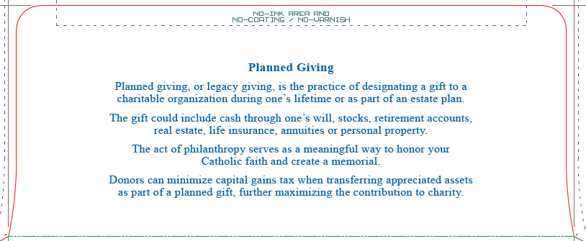
In-Pew envelopes

Slide 34
In-Pew envelopes
In-pew envelopes are a generic envelope in which parishioners can enclose their cash, check donation, or provide information for credit card or direct debit authorization.
There is space to indicate name, address, phone number, email, parish, etc.
Parishioners can indicate their gift in varying fields provided on the envelope.
The envelope has a bottom and a top once opened:
  Bottom: Cash, Check, QR Code for Online Giving
    also includes generic recommendations for giving
  Top: Credit Card and Direct Debit / Bank Authorization
A space for corrections is provided as well as additional information, such as email, phone number, and birthday.

Slide 35
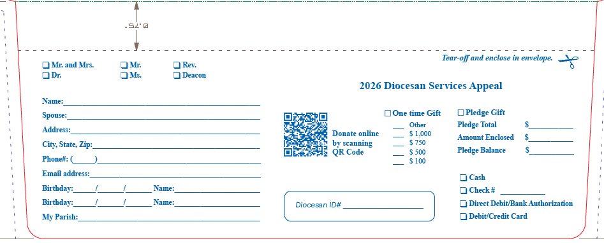
In-Pew envelopes (top)

Slide 36
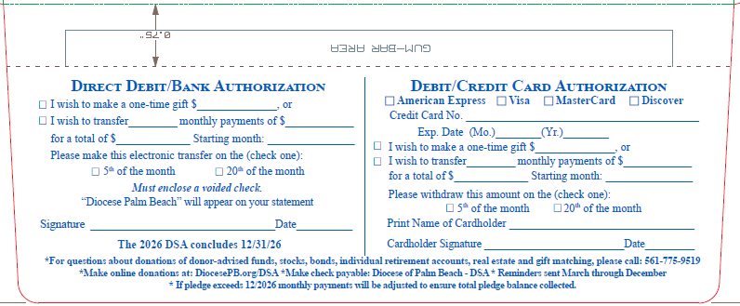
In-Pew envelopes (bottom)

Slide 37
Marking the In-pews
DO’S AND DONT’S
In-pew envelopes become tricky with illegible handwriting, which is why it is important for the information to be transferred to the transmittal sheet so that donations can be processed efficiently.
Please ensure all in-pew envelopes with credit card information and direct debit / bank authorization are included in the transmittal as well as recorded on the transmittal sheet.

Slide 38
DO’S
300.00
1333

Slide 39
DONT’S
X
300.00
0 Enclosed
X

Slide 40
Transmittals

Slide 41
Frequently asked questions
What is a transmittal?
How should they be sent?
How often should they be sent?
How are they processed?

Slide 42
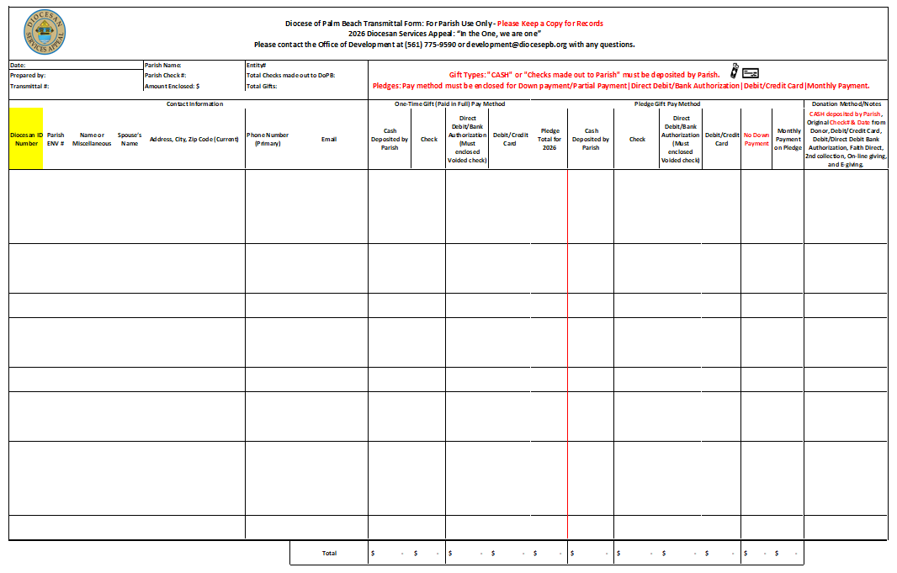
WHAT IS A TRANSMITTAL?
Transmittals are how parish bookkeepers and DSA contacts process and forward donations to the Development office to process and to credit donor’s accounts in the diocesan database.

Slide 43

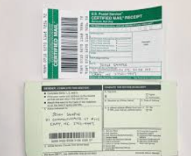
how should they be mail and what should they include?
Mail in a secure envelope certified mail preferred and include a copy of the DSA transmittal sheet. (Do not mail Cash or checks made out to Parish)
Parish check accounting for donations
Any checks made out directly to the Diocese of Palm Beach (Make sure to forward to Development Office ASAP).
Checks enclosed as a down payment for credit card and direct debit/bank authorization should also be included.

Slide 44


WHAT NOT TO INCLUDE IN YOUR TRANSMITTAL
Loose Cash
Checks Made Out to Your Parish
Keeping a record of all cash received at the parish and including all information with the transmittal sheet help us to answer questions when parishioners call about their donations. We cannot verify any donations by cash or checks made out to your parish without a written record, which is why the proper use of the transmittal sheet is essential.
By providing details we ensure that a record of cash donations is maintained, and that checks made out to your parish are endorsed in a timely manner so that parishioners can balance their accounts throughout the year.

Slide 45
how often should they be sent?
A parish may send transmittals on a regular basis according to demand or as often as necessary.
Why? This helps to ensure checks made out to the diocese and cards/envelopes with credit card and direct debit/bank authorization donation information make it to the Office of Development in a timely manner for processing to ensure pledges are scheduled immediately and checks are recorded and deposited ASAP.

Slide 46
how are they processed?
Transmittals are processed in the order they are received.
Incomplete transmittals will delay checks deposit and could affect Thursday’s parish reports to give parish DSA Goal updates to your parishioners.
Please provide all contact information from parishioners to ensure the Development Specialist can process donations correctly in Raiser’s Edge and credit parishioners properly.

Slide 47
Identifiers of the transmittal sheet

Slide 48
PARISH INFORMATION
Parish check#: Please write parish check number
Total Checks Made out to DoPB: Please add up total checks made out to Diocese of Palm Beach. (Make sure to mail transmittal to Development Office ASAP).
Amount Enclosed: Total including all payment method sent with transmittal
Transmittal#: Assign a transmittal number to keep track of submitted forms
Total Gifts: Please add up total # of all gifts submitted with transmittal

Slide 49
GIFT TYPES
Gifts can be made as follows:
Cash to parish
Check from donor to parish or DoPB
Credit Card
Direct Debit / Bank Authorization
Stocks / Securities, Matching Gift Foundations, Charitable Trusts, etc.
These gifts may come as:
One-Time Gift (Paid in Full)
Pledge with Down Payment
Pledge with No Down Payment
Payment on Pledge

Slide 50
TRANSMITTALS COPIES
Please ensure that you are including a copy of the provided transmittal sheet, and that you are retaining your own copy of the transmittal sheet for records throughout the year.
It is essential that all parishes make use of the same transmittal sheet for consistent recordkeeping and to boost processing efficiency.

Slide 51
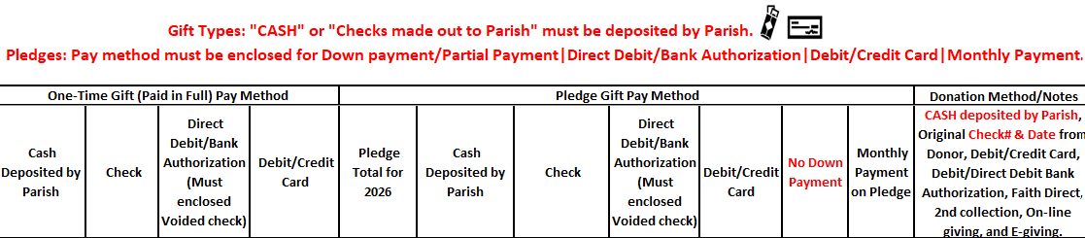
REFERENCE CELLS FOR GIFT TYPE
Group donations by:
Paid in Full
  One-Time Gift
Pledges
  Pledge with Down Payment
  Pledge with No Down Payment
  Payment on Pledge
Any miscellaneous or anonymous donations please add at the end of transmittal

Slide 52
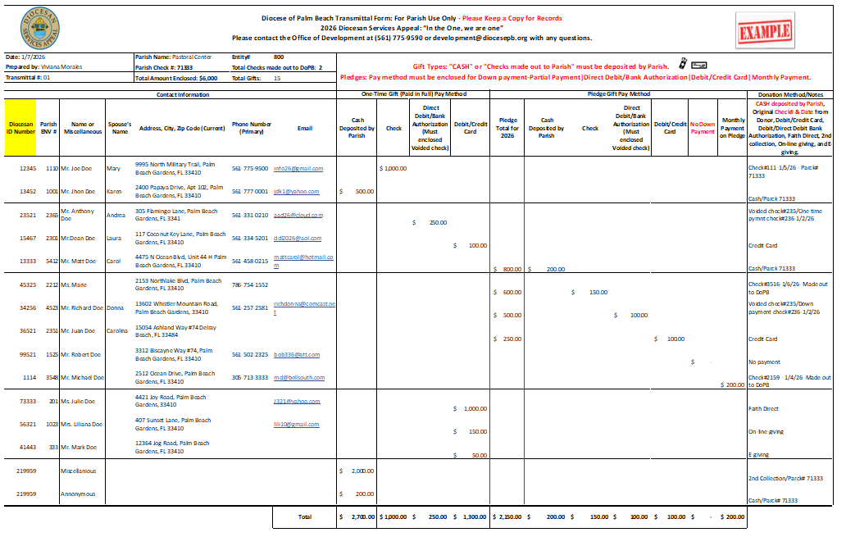
HOW TO SUBMIT YOUR TRANSMITTAL

Slide 53
REFERENCE CELL FOR FAITH DIRECT, ONLINE GIVING, E-GIVING, AND 2ND COLLECTION.
You may also receive donations for DSA in your second collections or through your parish’s online giving system (e.g., Faith Direct).
Please include these in your parish check and indicate on the transmittal sheet from where they were received.

Slide 54
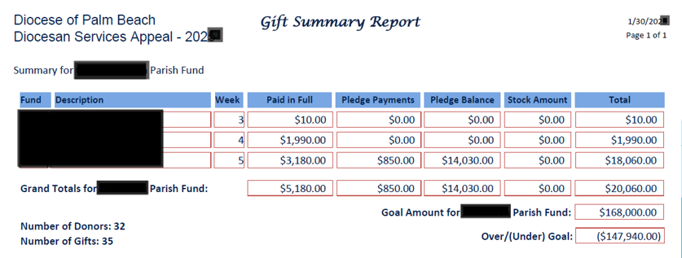
PARISH REPORTING
Reports are run every Thursday and saved under FTP “Parish folder”.
Excel Detail report by donor:
PDF Summary report by week with DSA Goal:

Slide 55
Parish Updates

Slide 56
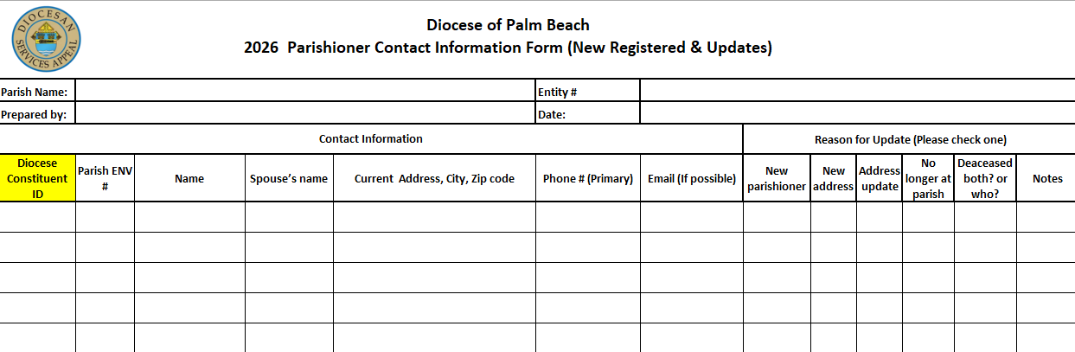
Parishioner contact information form

Slide 57
key details
Diocesan ID Number (typically 5-6 digits found on both the parish roster and parishioner labels with barcodes)
Indicate if you are unable to find the ID number or if they are a newly registered parishioner
If you do not have an ID number for your parishioner, it is likely they submitted an update directly to the diocese in the updates section of their pledge card.

Slide 58
PARISHIONER INFORMATION
Include (Highest Priority):
Address
Phone Number
Email
Include if Possible:
Spouse’s Name
Spouse’s Email
Spouse’s Phone Number
If any of this information is new, being provided to your parish by the parishioner as an update, please indicate this on the transmittal sheet so that we know to make the appropriate updates in our diocesan database.

Slide 59
PARISHIONER Updates
Submit
monthly updates to keep records currents in our data base by using parishioner contact information form.
Notify
development office as soon as you have information for any deceased parishioner to ensure family does not receive any solicitations.
Check
FTP folder for all updates that parishioners sent directly to our development office.

Slide 60
IMPORTANT NOTES
Do not send loose cash or checks made out to your parish in transmittals.
  Record and deposit all checks and cash in a timely manner.
  The only checks that should be included in a transmittal are your parish check and checks made out directly to the diocese (for parishes unable to cash DoPB authorized checks).
  Include checks made out as down payment for credit card or direct debit / bank authorization on your transmittal. Indicate on transmittal sheet (slide 52)
Open in-pew envelopes and please transfer personal information to transmittal sheet with the exception of credit card information and direct debit / bank authorization.
Parishioner updates will be scanned and uploaded to your FTP folder monthly.
When prompted, send all parishioner updates to development@docesepb.org

Slide 61
Tax Letters
& Donations to parish

Slide 62
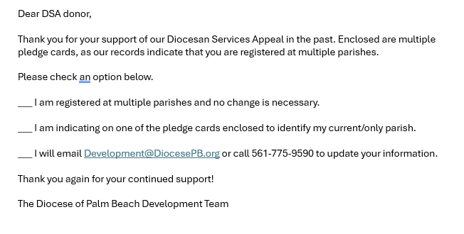
Constituent updates and donors with multiple parishes
Please email Development@DiocesePB.org when you have parishioner updates, are notified of a deceased, divorced, married, etc. parishioner
Please check FTP site each month for updates that we receive, so you can update your records
We have approximately 3,300 constituents that belong to multiple parishes. They will receive a new style of buck slip in their solicitations
• 3,204 with two parishes
• 76 with three parishes
• 9 with four parishes
• 2 with five parishes
• 2 with six parishes

Slide 63
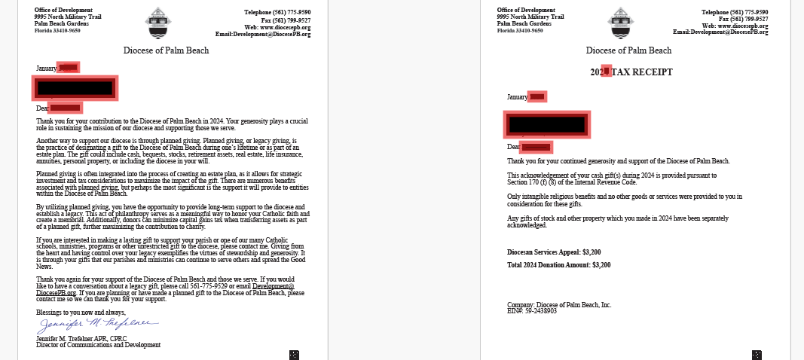
TAX letters
For donations recorded by DoPB:
Parishes do not need to send the tax letters
The diocese will mail tax letters in January 2026 for 2025 gifts for $250 or more
Donor needs to contact development office for donations that are less than $250

Slide 64
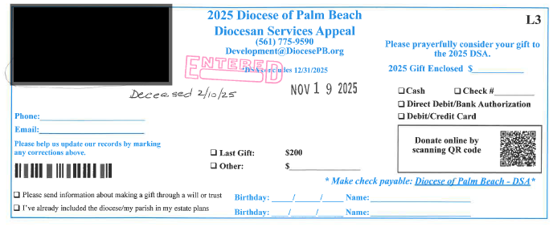
Parishes not submitting monthly updates for deceased parishioners
Deceased 2/10/25 notified by family to DoPB 11/19/25
Challenges with updates

Slide 65
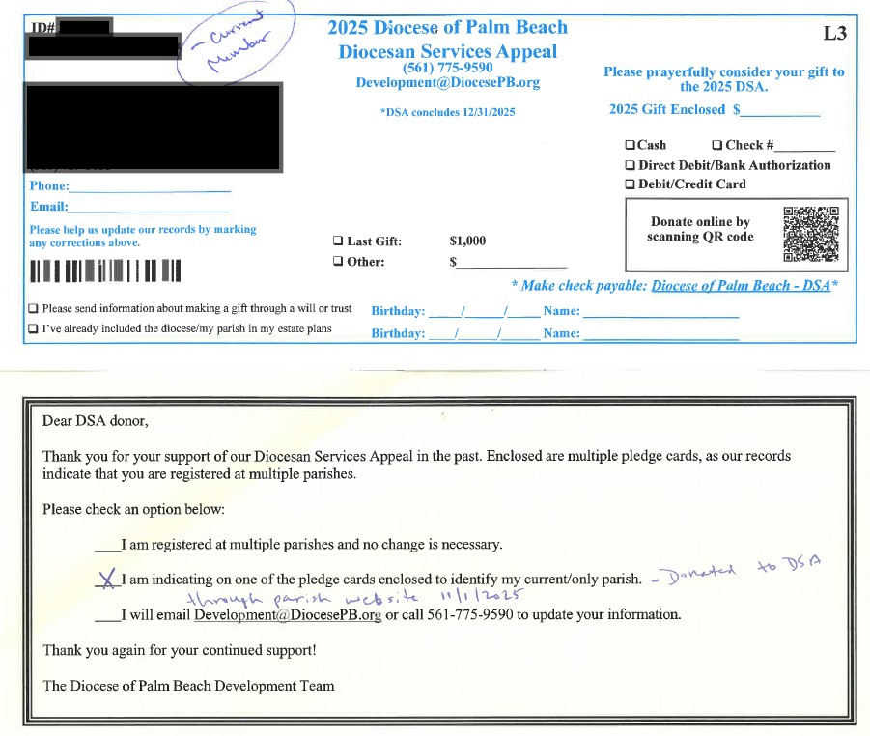
CHALLENGES WITH DSA donations to parish
Donor submitting donations for DSA through parish website and not reporting donations to Development office

Slide 66

CHALLENGES WITH DSA donations to parish
Parish mailing donations:
  First-Class mail with no back-up details
  Loose Cash not certified mail
  Sealed envelopes with checks made out to parish

Slide 67
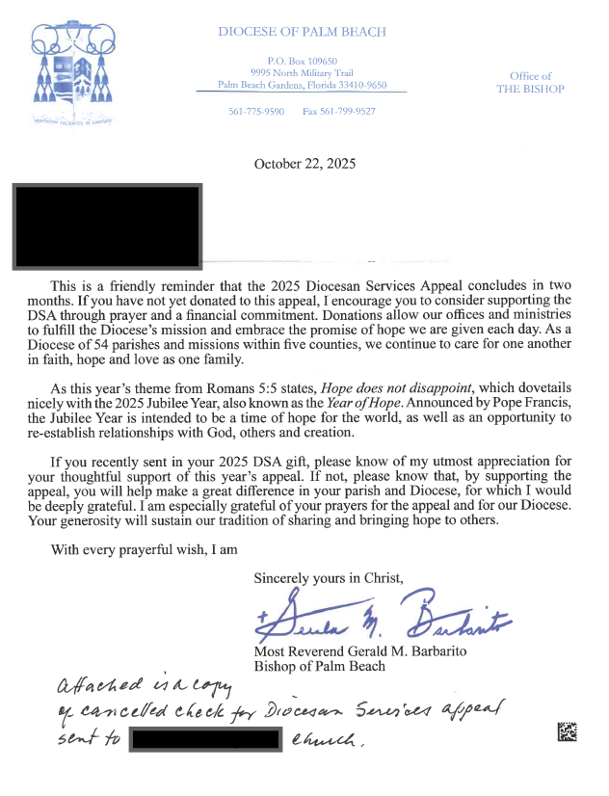
CHALLENGES WITH DSA donations to parish
Donor submitting donations for DSA through parish offertory/collections and not reporting donations to Development office.

Slide 68
DO YOUR BEST!!!
If you have questions, please do not hesitate to call our office. We are here to support you, and more than happy to answer your questions and to walk you through the transmittal process to ensure excellent service to your parish and the parishioners of our diocese.
You are our Priority
We are ONE!

Slide 69

Thank you
Please complete the survey before leaving
We are happy to answer any questions you may have
Blessings to you and your parish now and always

