Slide 1

Diocese of
Palm Beach
Parish and Schools Communication Meeting
October 16, 2024

Slide 2

Welcome and Prayer
Goals of the meeting
Mentimeter
Plan for the day

Slide 3
Our Communications Team
Jennifer M. Trefelner, APR, CPRC, Director of Communications and Development
Jackie Nadel, Multimedia Graphic Design Coordinator
Theresa Kisrow, Communications Manager
Bill Cone, Reporter/Photographer/ Digital Production Coordinator

Slide 4

Introductions
Name, parish or school, title
Meet your neighbors!

Slide 5
Sandi harpring -
John Carroll High School
Scheduling solutions through automation
Calendly, personalized booking, automatic calendar syncing, and more
How can Calendly fit your needs?

Slide 6


DIOCESE OF PALM BEACH
OFFICE OF CATHOLIC SCHOOLS
Streamlining Campus Visits &
Improving Efficiency

Slide 7

SCHEDULING CHALLENGES
01
Manual Coordination
Often involved numerous back and forth emails or phone calls, which was inefficient.
02
Limited Staff Resources
Difficult to keep up with requests for campus tours and meetings.
03
High Volume
Interest in admissions continues to rise, presenting challenges in managing meeting requests and maintaining day-to-day operations.
04
Lack of Automation
The absence of automated scheduling meant that all scheduling tasks had to be performed manually.
05
Impact Customer Service
The time nature of scheduling could negatively impact the customer experience.

Slide 8
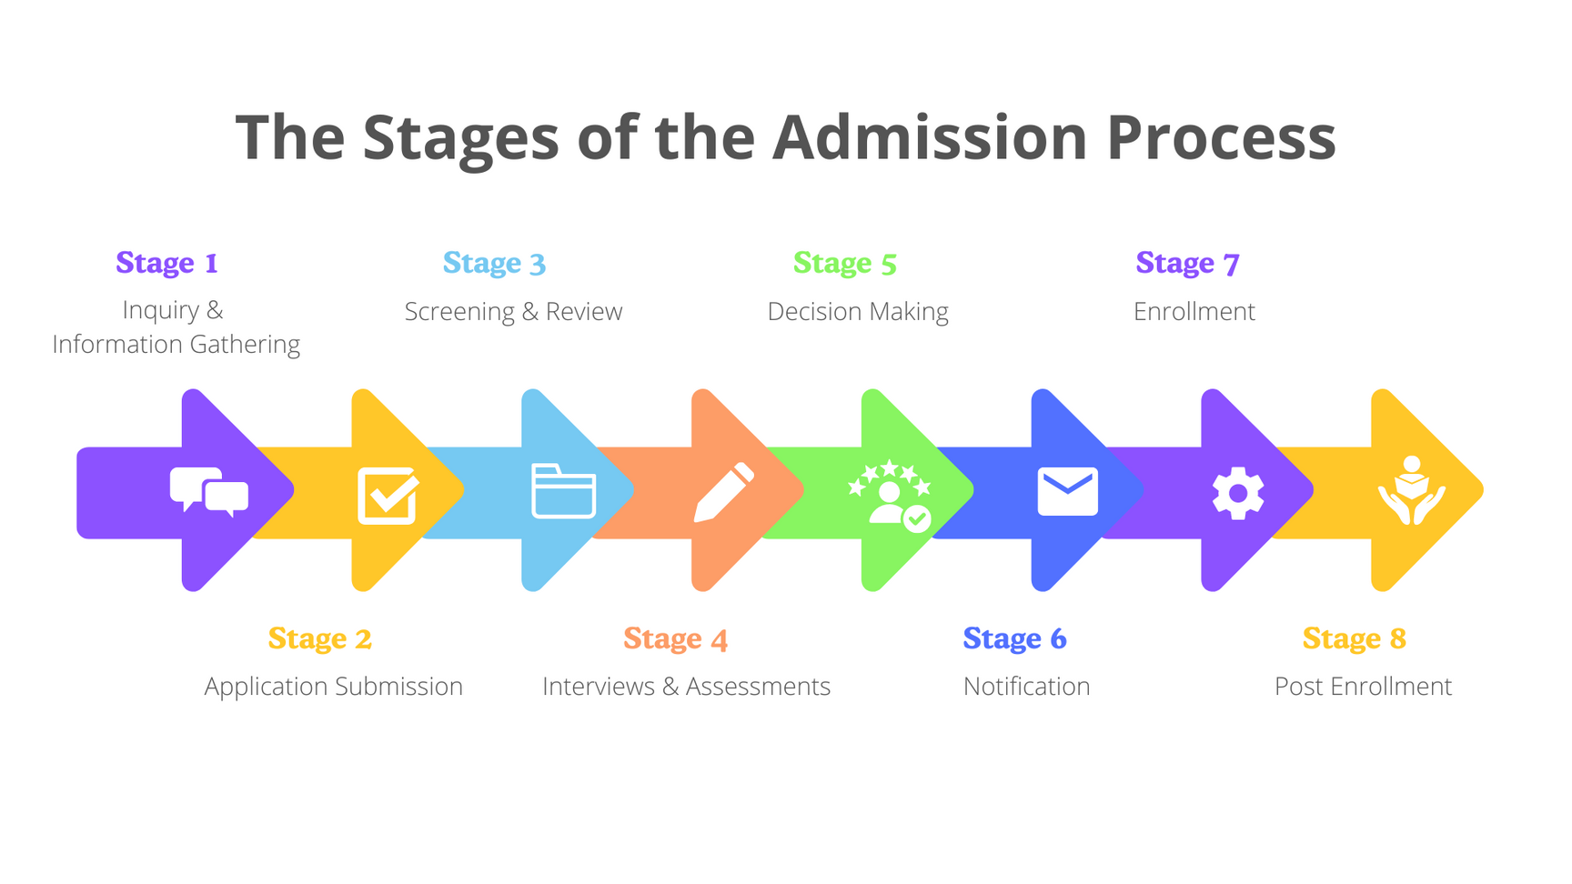

THE SOLUTION
By addressing these challenges through automation our admissions office streamlined the scheduling process throughout every stage of the admission funnel, reduced the time spent on logistics, and enhanced the overall experience for prospective students and their families.
Calendly makes it easy to work smarter when you’re working solo.

Slide 9

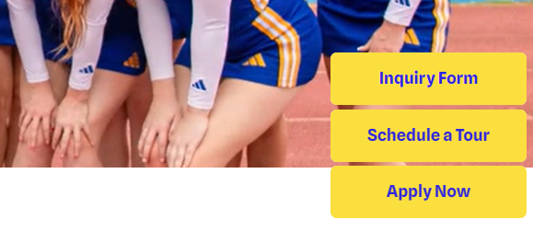
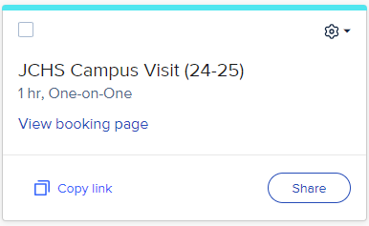
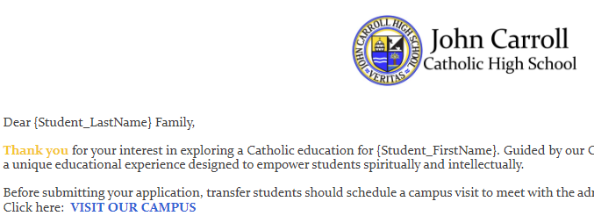
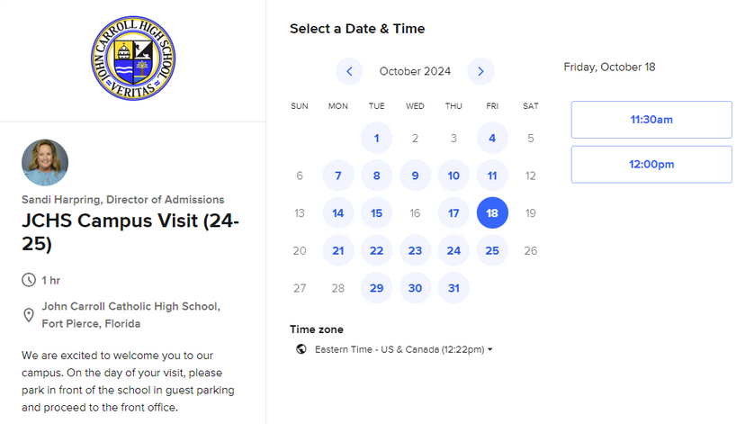
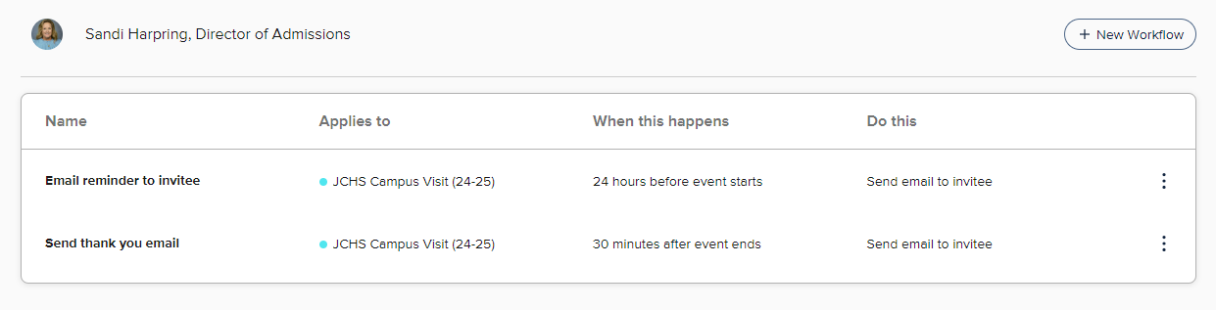
Website
CALENDLY
1.
Personalized booking link to add to email templates and website.
Email Templates
2.
Meetings automatically sync with calendar.
3.
Other administrative tasks automated.

Slide 10
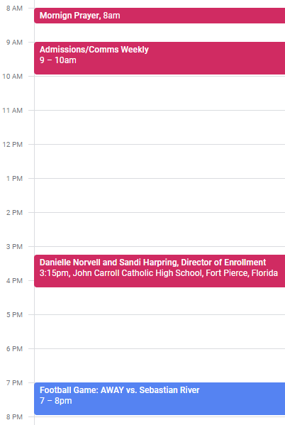
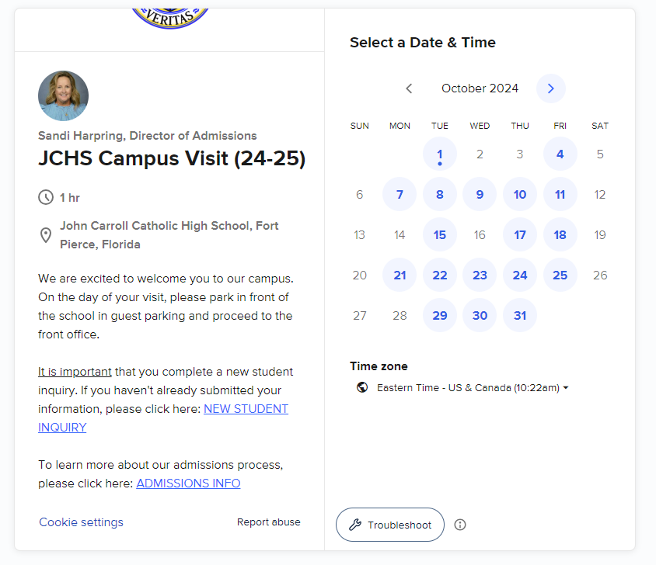
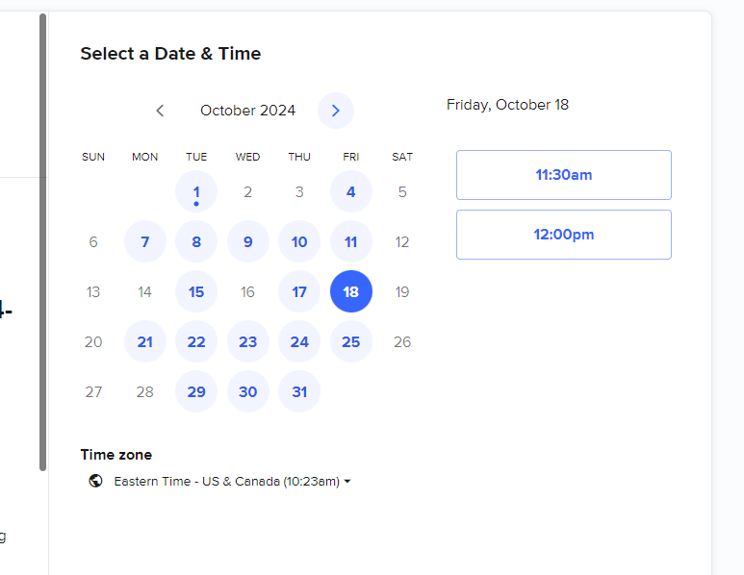

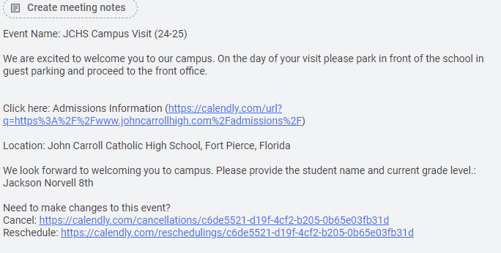


BOOKING PAGE
Branding
Calendar Integration
Availability
Gather information during booking
Personalized Message with Links

Slide 11
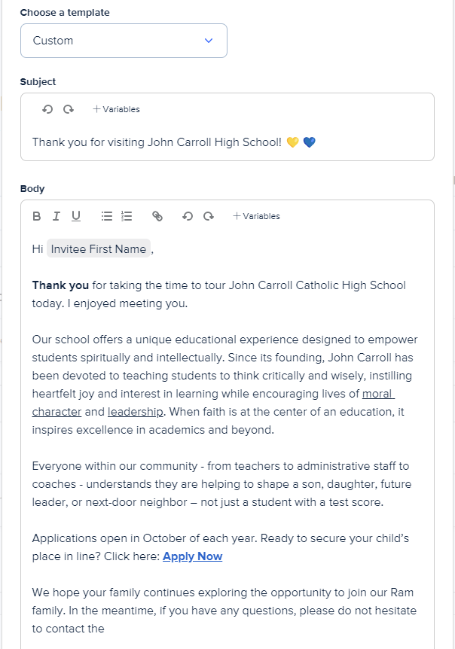
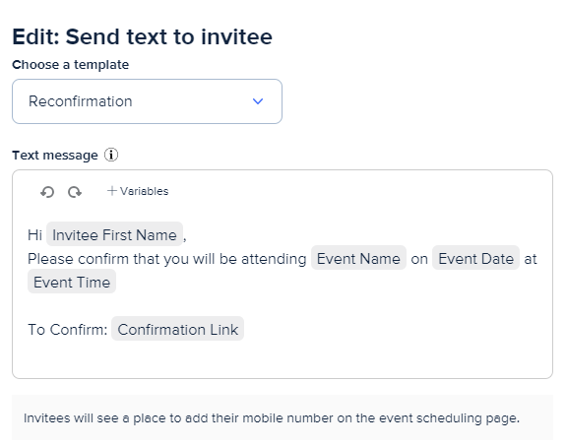
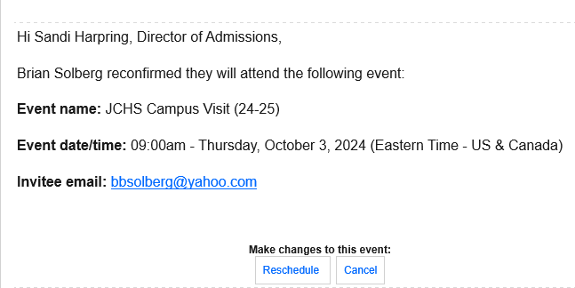
MORE AUTOMATION
Templates to Create Workflows
Text
  Reminder
  Confirmation
  Re-Confirm
  Cancellation
Emails
  Thank you
  Confirmation
  Feedback Survey
  Additional Resources
Email Notice of Reconfirmation

Slide 12

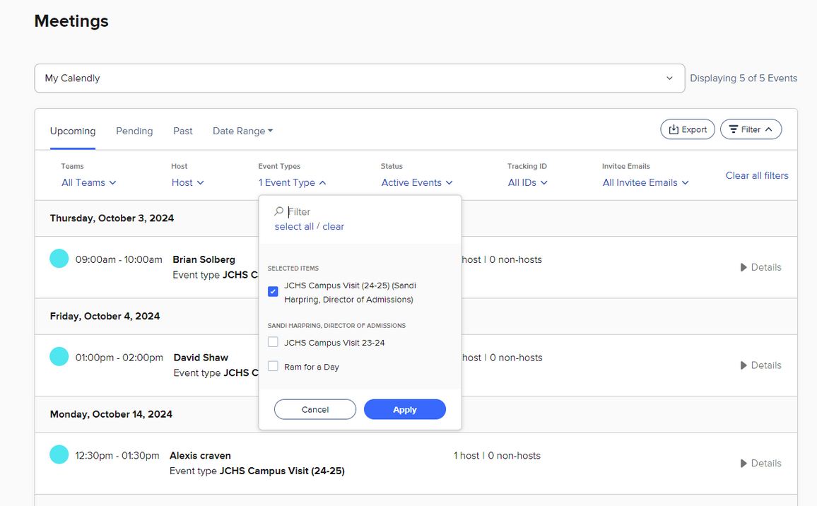
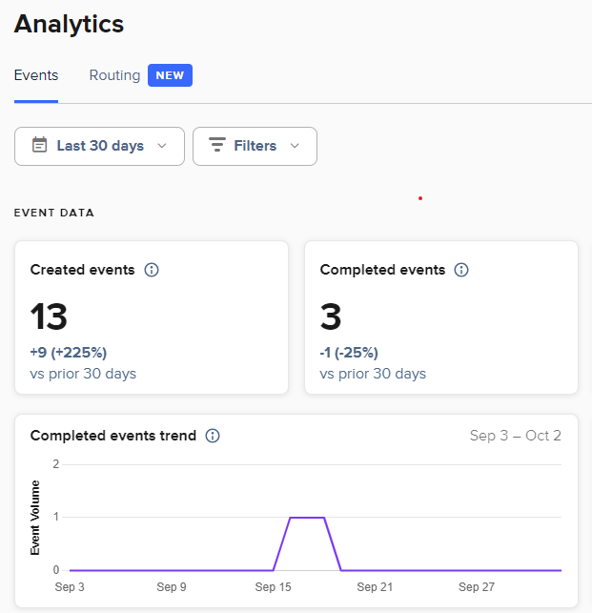
ANALYTICS
Easy Access to Data
Total scheduled
Export
Filter & sort by events.
User friendly analytics toolbar.
Details

Slide 13

EFFICIENCY
RESULTS
Automatic Scheduling: Eliminated back and forth emails allowing prospective families to book directly providing added flexibility. This saved time for both staff and families.
24/7 Availability: Improved response times by allowing bookings at any time of day even outside office hours. Provided easy access and ensured that prospects needs are addressed immediately.
Calendar Integration: Ensured that all appointments were automatically added to the admissions calendar, reducing the risk of double bookings or missed appointments.
Time Savings: In the initial roll out Calendly saved over 25 hours of staff time automating the scheduling process, during the busiest time of our admission cycle. This allowed staff to focus on more critical tasks.
EFFECTIVENESS
Customized Booking Page: Provides customize booking pages to gather necessary information from prospects beforehand. Combined with FACTS SIS this allowed us to prepare a more personalized and effective visit for new families.
Increased Engagement: Calendly has contributed to a 58% engagement rate on traffic to our website, with high quality visitors who are more likely to visit our school and apply for admission. The program helps to maintain regular touch points fostering stronger relationships with prospective families.
Automated Reminders & Follow-Ups: Calendly sends automated reminders before meetings and follow-up messages after a visit. This helped to reduce no-shows and ensured that new families received the information and support they need before having to ask.
Data & Analytics: Provides insights into booking patterns and visitor preferences, which help optimize scheduling and improve the overall experience for the prospective student.

Slide 14

Brainstorm Ideas
Calendly can be a fantastic tool for schools & churches to streamline their scheduling and improve communication. Here are some ideas to use Calendly:
  Shadow Days: Schedule prospect student visits.
  Facility Booking: Meeting rooms, or parish hall.
  Student Advising: Schedule meetings with Guidance counselors, orientation sessions.
  Classes & Workshops: Bible studies, sacrament preparation, or workshops.
  Financial Aid Meetings: Schedule meetings to review FACTS Grant & Aid applications.
  Scheduling for Mass Intentions: Set up a Google calendar for mass intentions and link it to Calendly.

Slide 15


GETTING STARTED
  Basic feature is FREE!
  One event type with unlimited meetings
  Connect one calendar
  Customized booking page and link
  Confirmation emails
  Standard version is $10 per month
    Unlimited event types
    Automate reminders
    View analytics

Slide 16
Stephany lang –
St. Vincent Ferrer school
Social media strategies and planning
Making the most of your posts through analytics and reviewing your most viewed content
Creating content that reaches your audience and maintaining your brand

Slide 17

Social Media and Digital Marketing
Strategies for expanding online presence in the digital age
Stephanie Lang
St. Vincent Ferrer School
Admissions & Social Media Specialist

Slide 18
Key topics:
1.
2.
3.
4.
5.
SOCIAL MEDIA STRATEGIES
SOCIAL MEDIA ANALYTICS
MOST VIEWED CONTENT
CONTENT CREATION & MARKETING
BRANDING

Slide 19

Social Media Strategies
  Develop a monthly social media plan outlining your goals.
  Review the previous year's content to identify what worked.
  Maintain consistent branding to ensure your content is easily recognizable.
  Engage with your followers to cultivate a sense of community.
  Use social media analytics and insights to see who your target audience is.
  Aim for variety in your posts, incorporating single images, reels, videos, and collages.

Slide 20
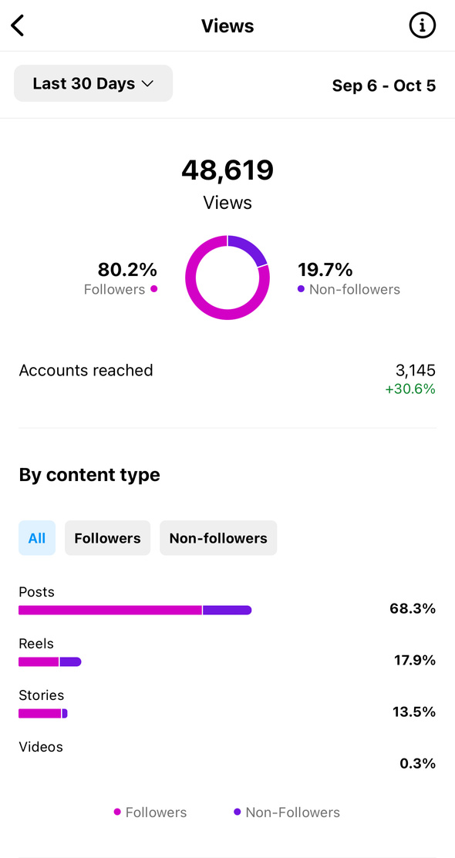
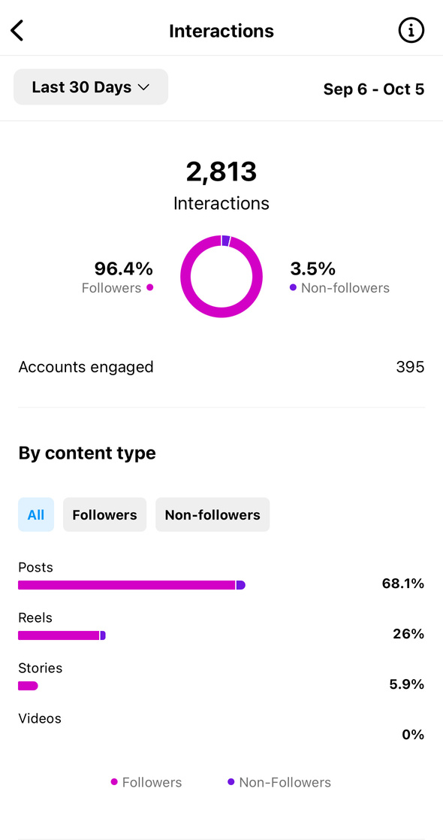
Instagram - Professional Dashboard
Social Media Analytics
  View Your Insights for the Last 30 days by Content Type
  Breakdown by Followers, Non-Followers, and All Views, from content shared
  Personalization, Ideas for Creation, Engagement and Reach with a “Best Practices” under Tools
  Content You Shared is a great tool to see your most liked posts / viewed reelss

Slide 21
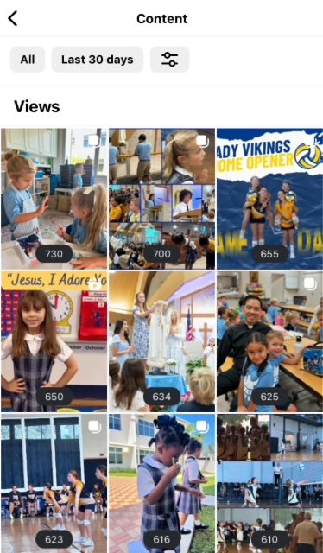
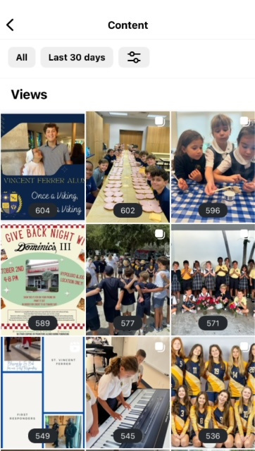
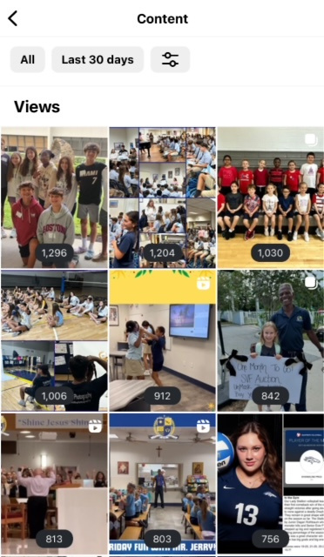
SVF’s Most Viewed Content
1.
3.

Slide 22

  Explore the content marketing / digital marketing strategies of other Schools or Parishes.
  Identifying your target audience and what they are interested in seeing through your platforms.
  Develop and create valuable, informative, and entertaining content.
  Optimizing content for search engines and google analytics.
  Storytelling and authenticity in the content you are sharing.
Content Creation and Marketing

Slide 23

Online Branding
Strategies for building and managing an online presence:
  Establishing brand identity (logo, colors, font) Should be the same on your website and when you print materials.
  Maintaining brand consistency across all online and print platforms (social media, website, print)
  Using your mission and motto to create content for your platforms
  Driving traffic from social media to other platforms you want your audience to be a part of: website, principal’s bulletin’s, alumni news, etc.

Slide 24
Laura zele –
Cardinal newman High School
A weekly newsletter can streamline and organize communication
Keep it fun and engaging with news, reminders & graphics
Engage your whole community through updates & special events

Slide 25

UNITING & ENGAGING FAMILIES THROUGH A WEEKLY NEWSLETTER
Cardinal Newman High School

Slide 26
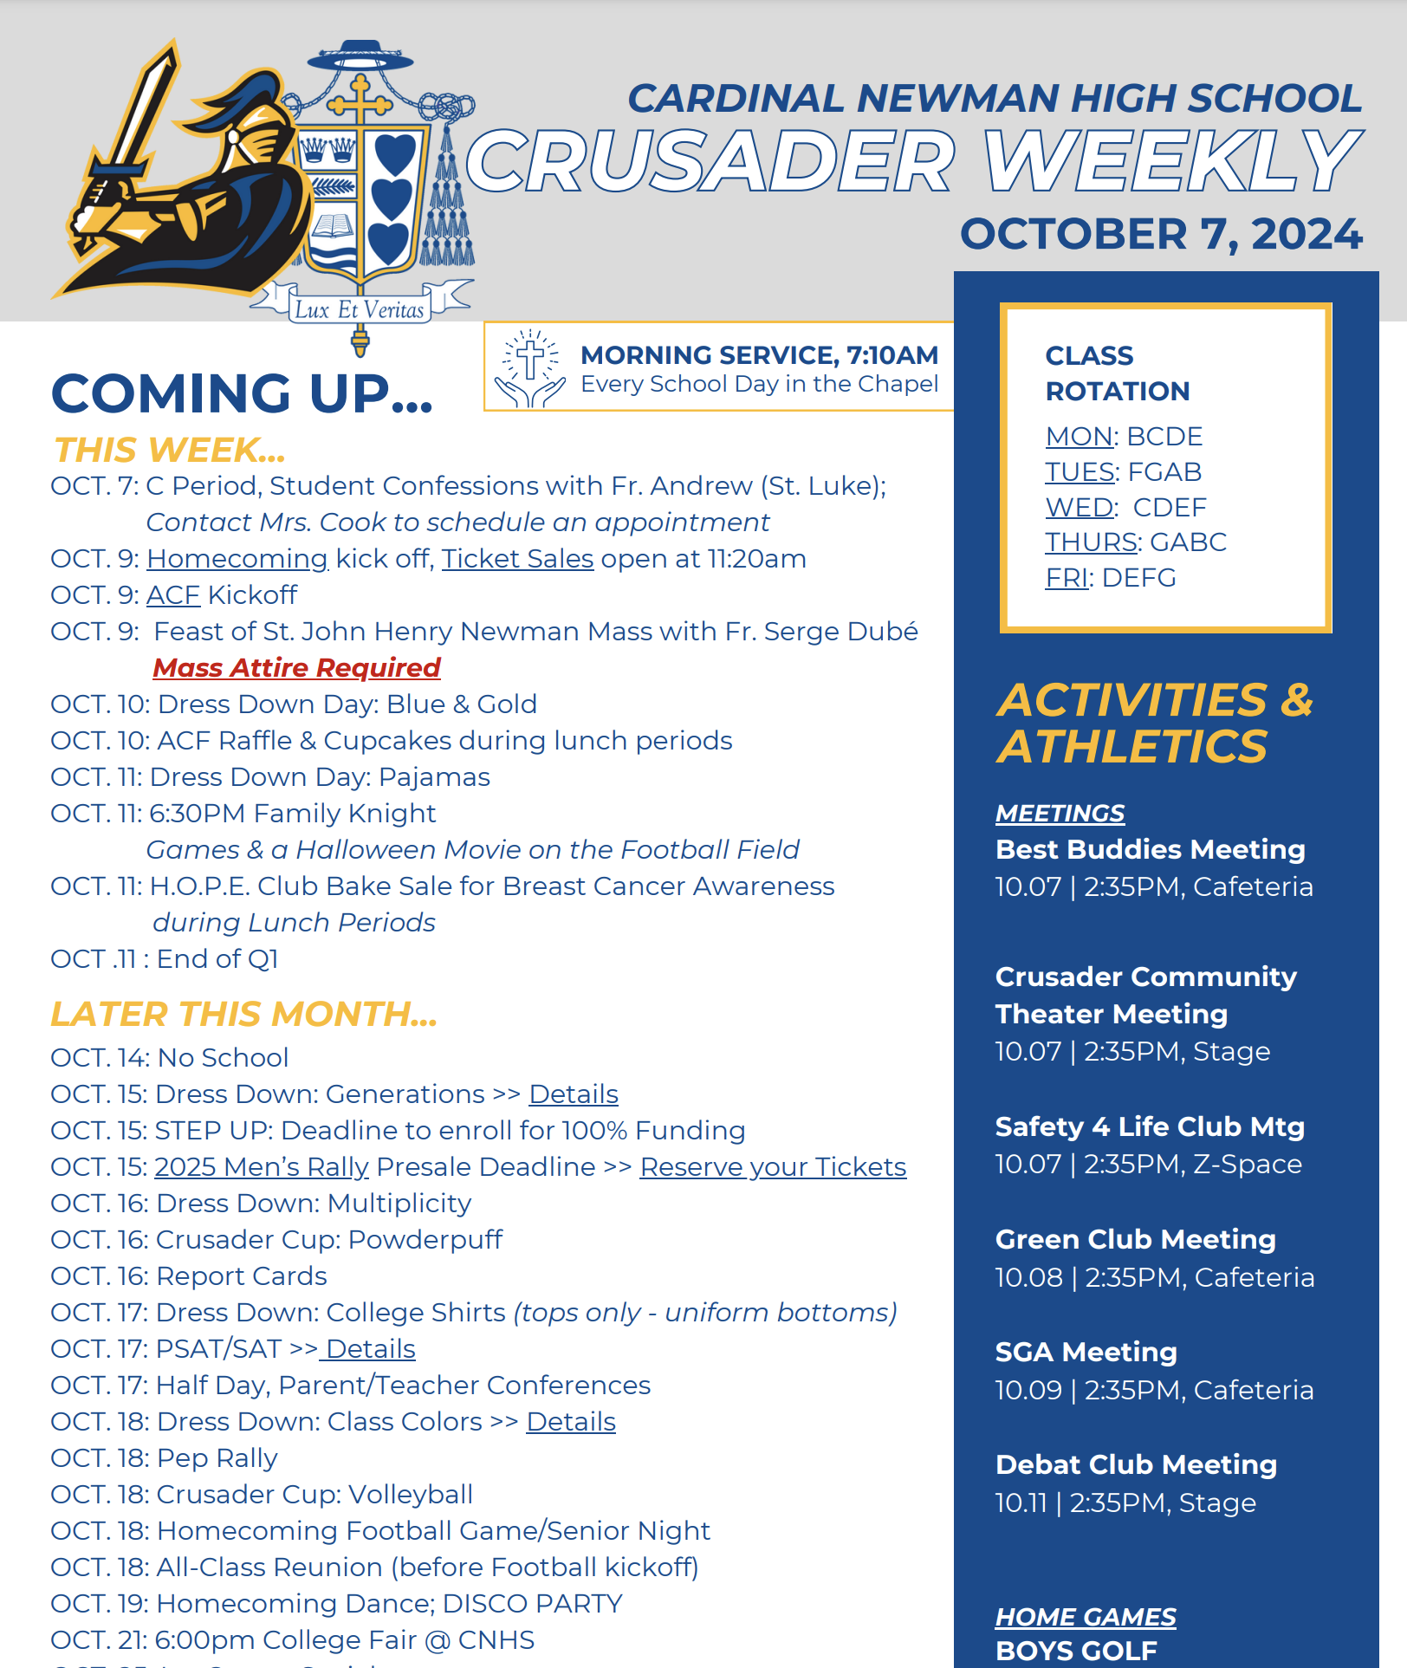
GOALS
Streamline important news and dates to enrolled families
Organize delivery of key information in a way that is easy to refer back to as needed
  Core info can be downloaded/saved as PDF
Provide an opportunity to look ahead and prepare

Slide 27

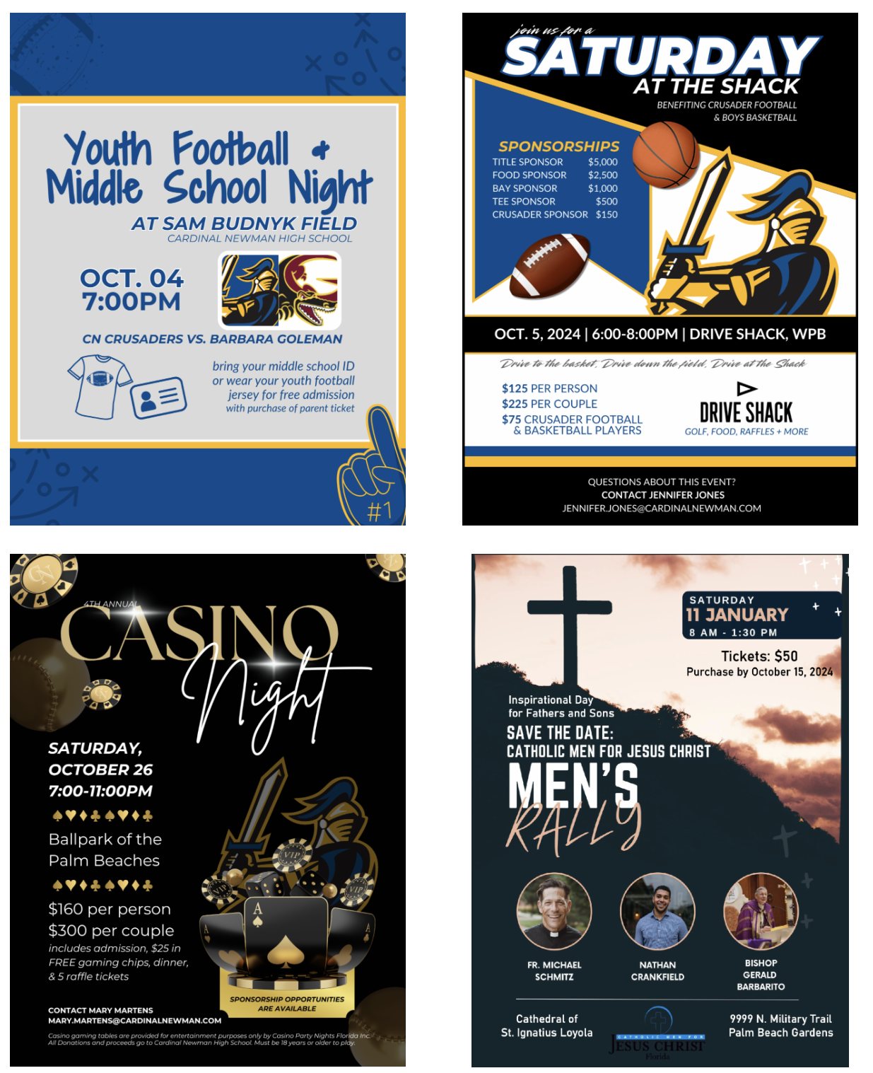
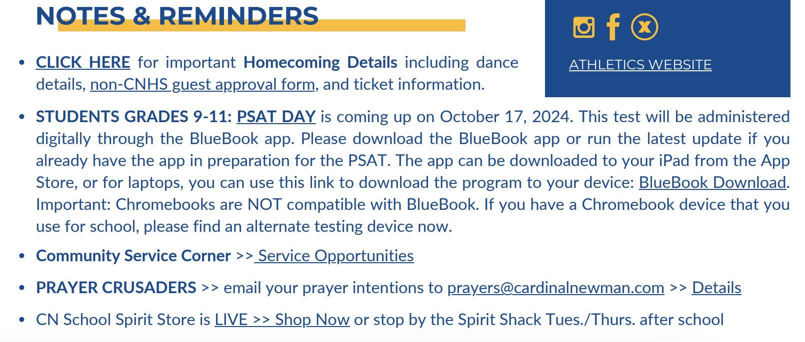
KEEPING IT FUN AND EXTENDING COMMUNITY INVOLVEMENT…
News & Reminders are included to provide more detailed information
Supporting graphics and advertisements are included underneath key dates
  Including news and updates from our extended community

Slide 28
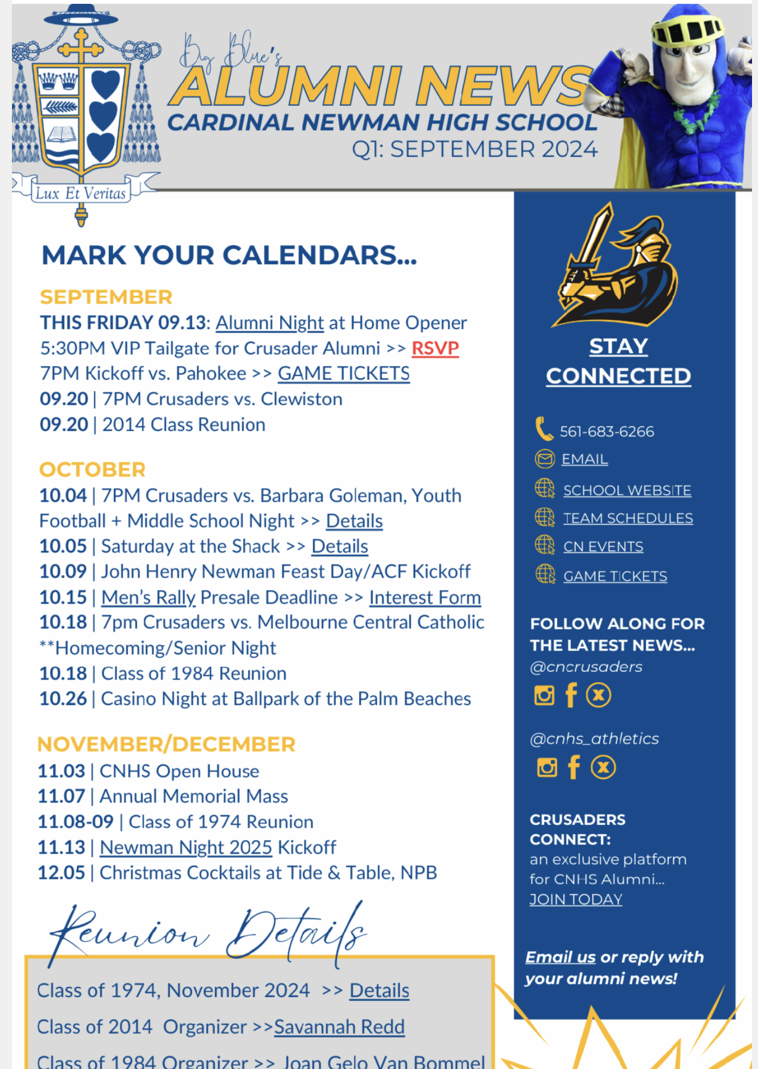
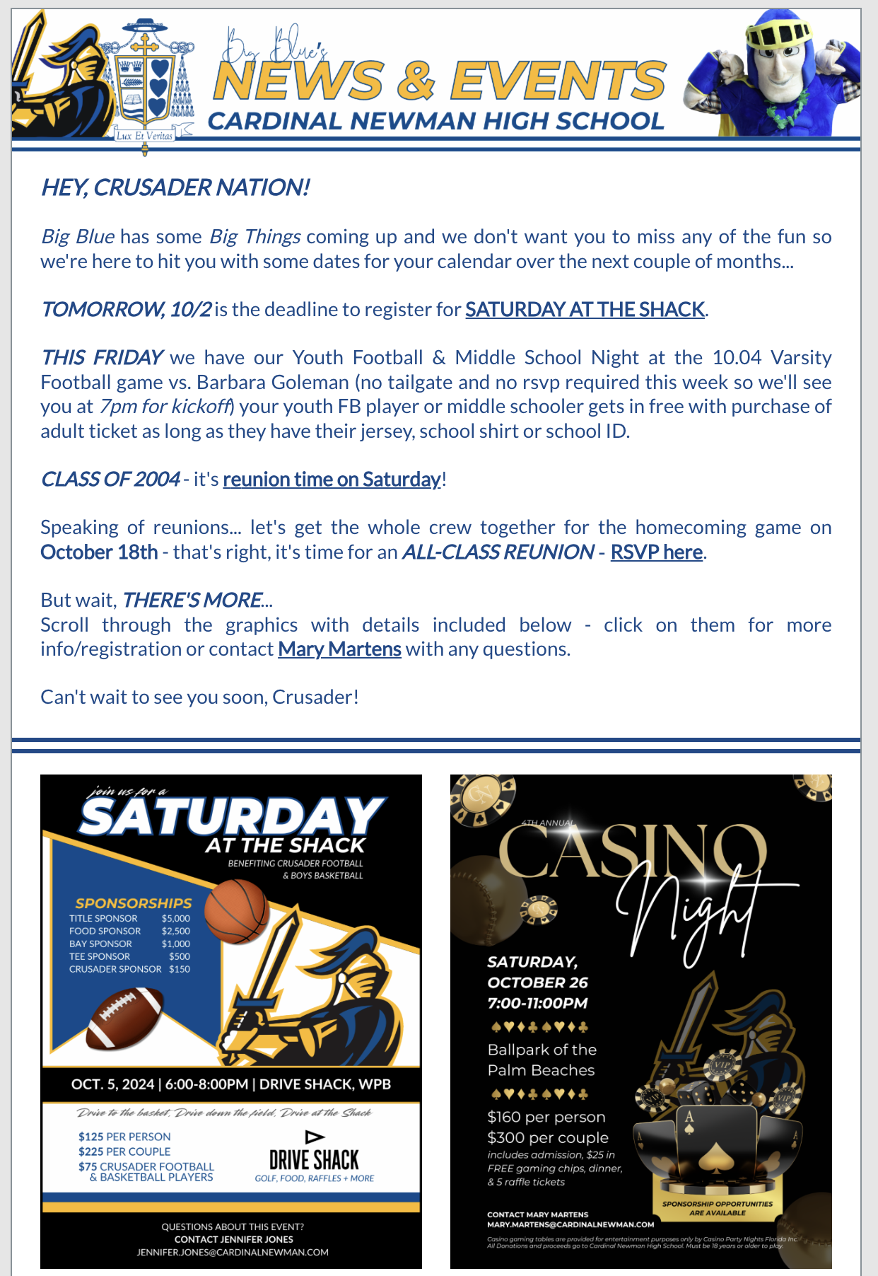
ENGAGING ALL CRUSADERS…
Quarterly updates geared toward supporters and alumni
Special Events emails as needed

Slide 29
Crusader Weekly 09.30.24
Alumni News September 2024
Special Events 10.01.24

Slide 30
Colleen head – st. Patrick church
Working with Canva to create your own magazine
Personalize your parish magazine to your community
Working with a graphic designer to complete the project

Slide 31
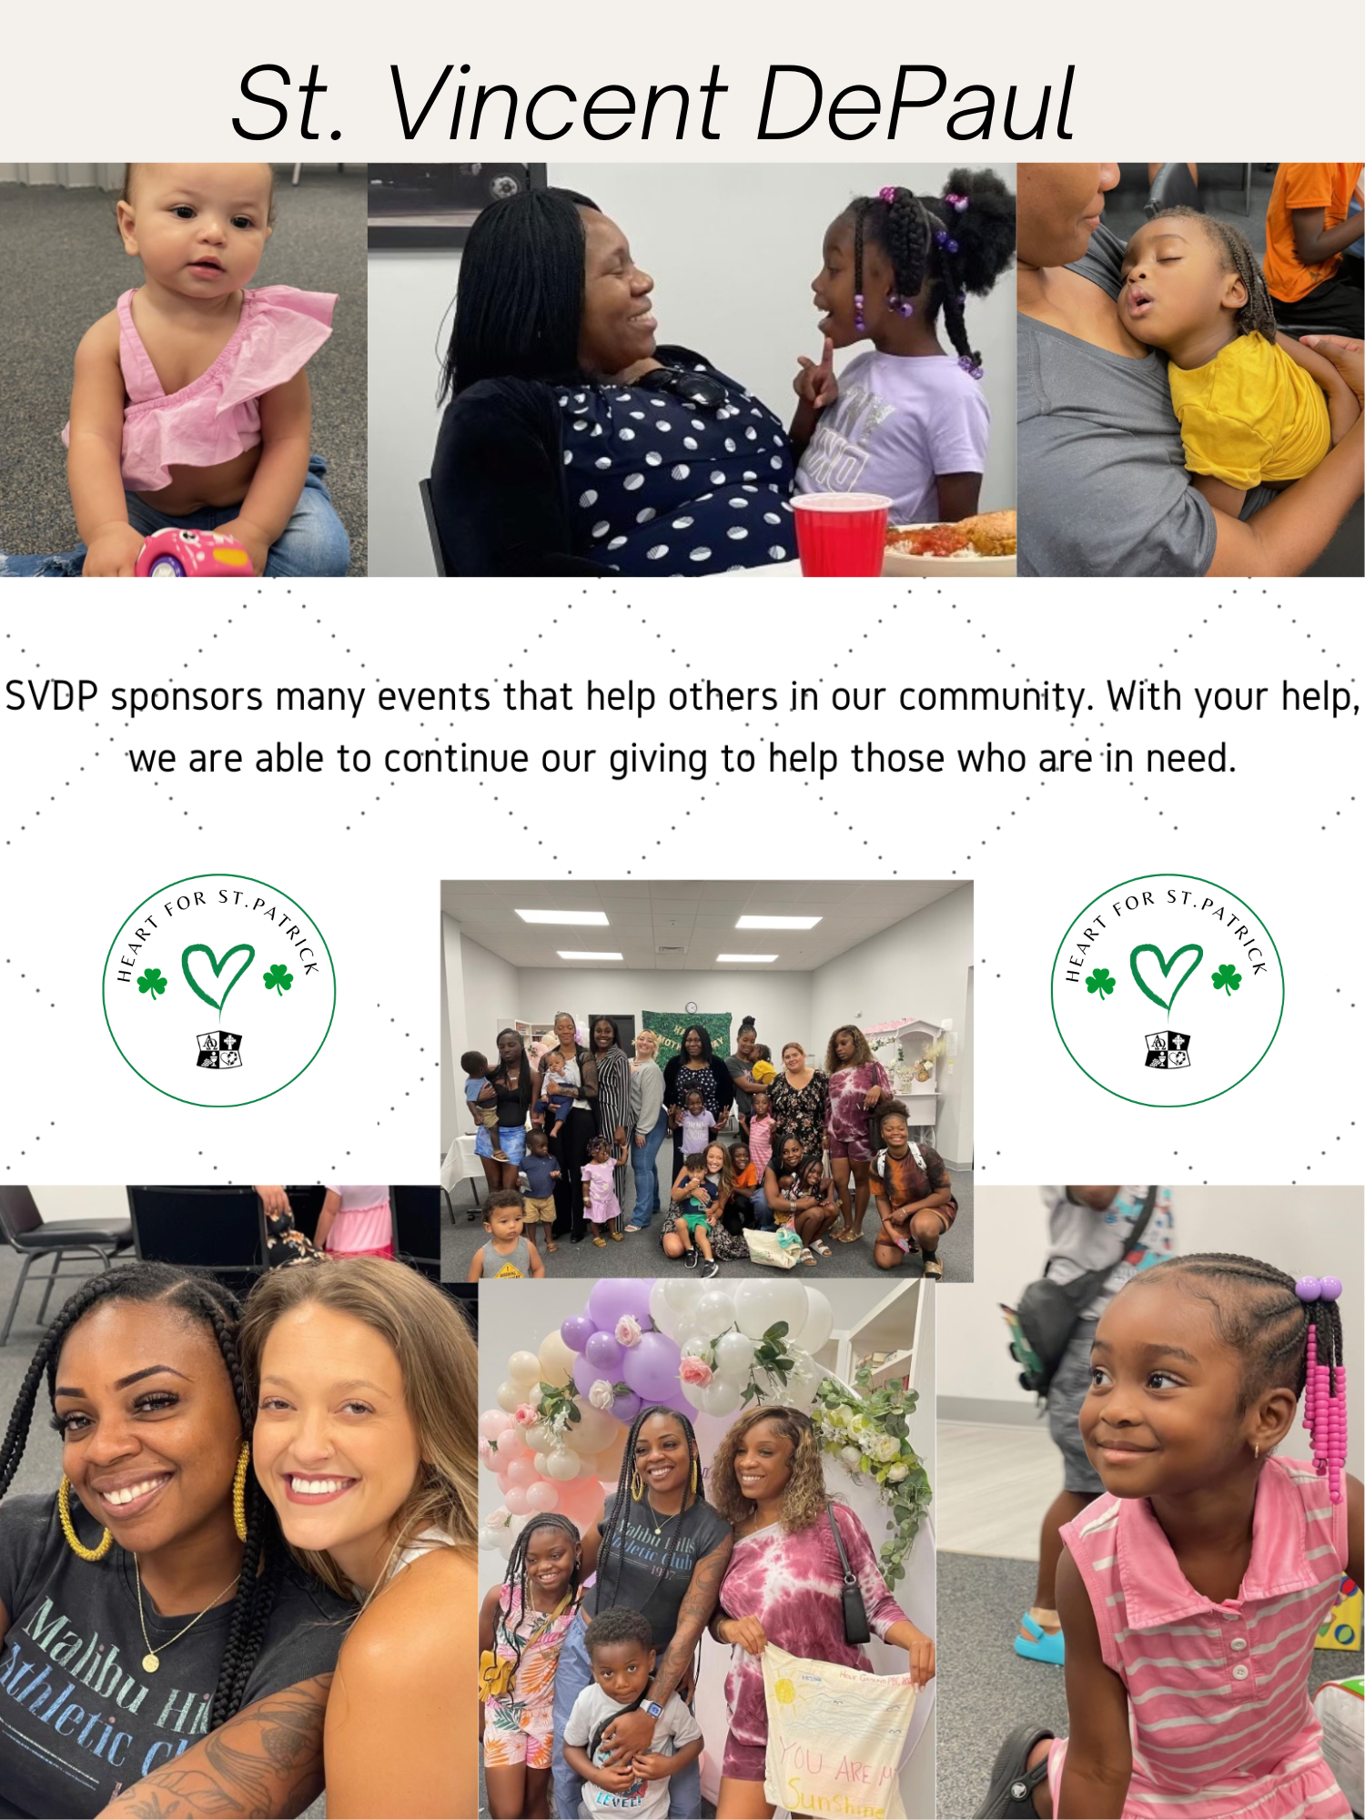
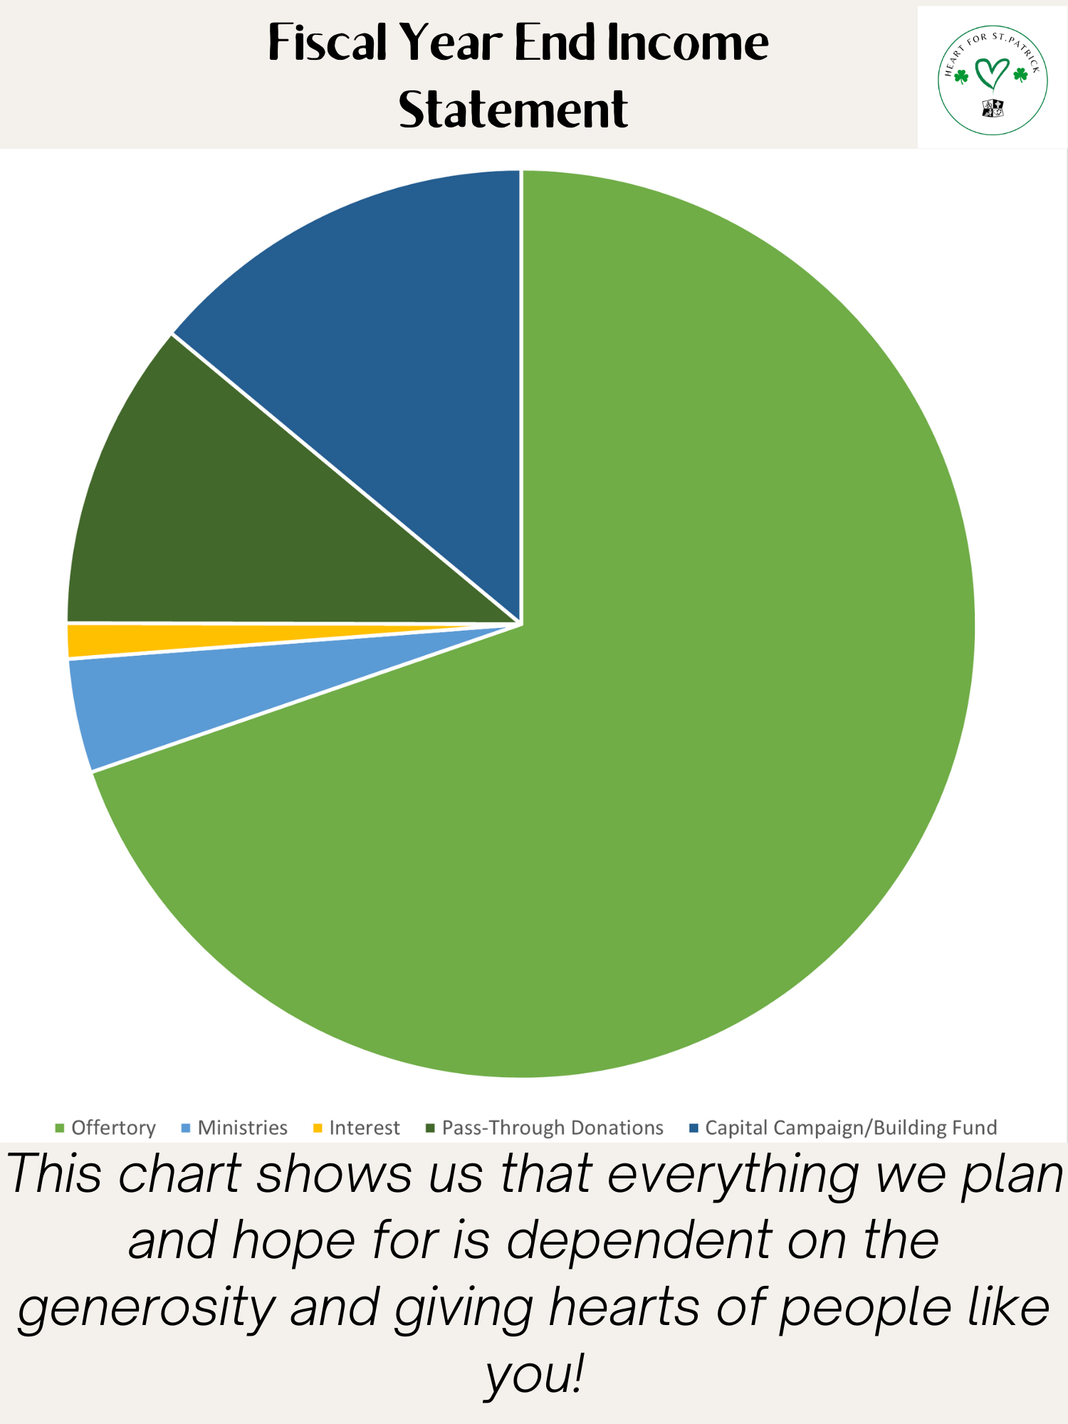


Slide 32
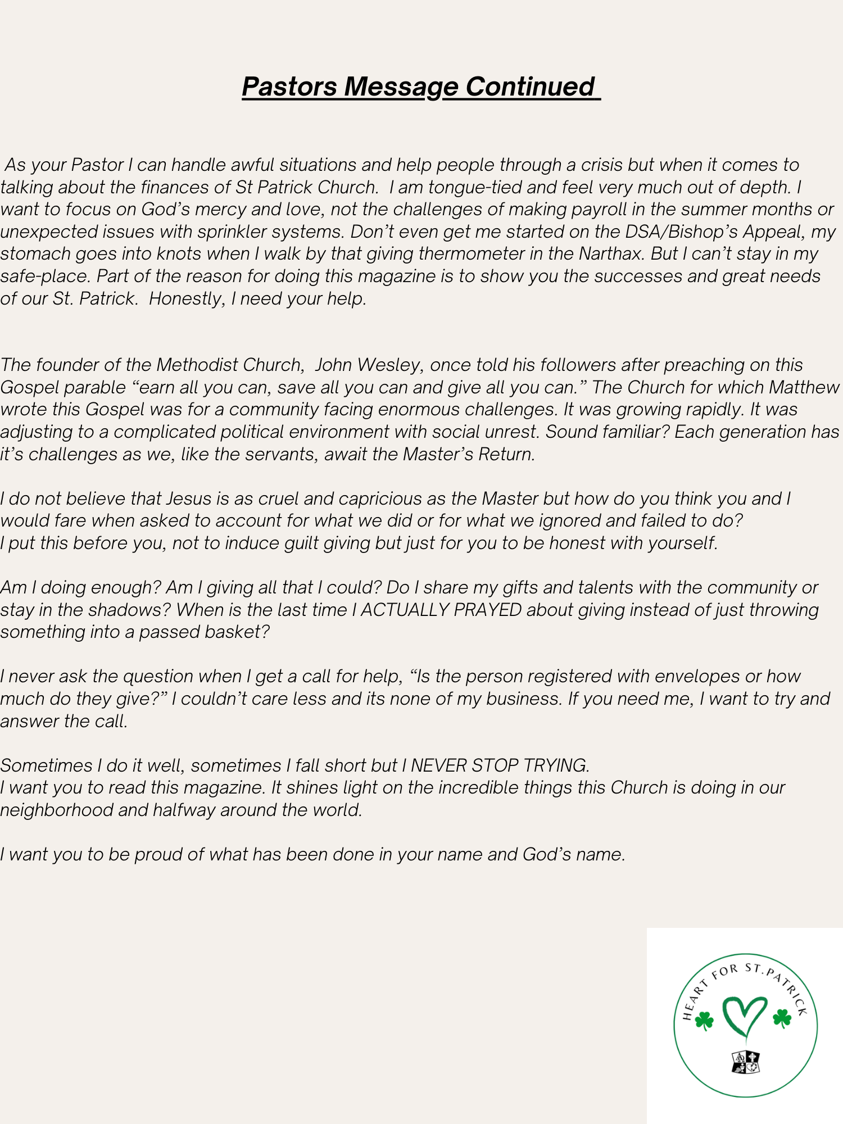
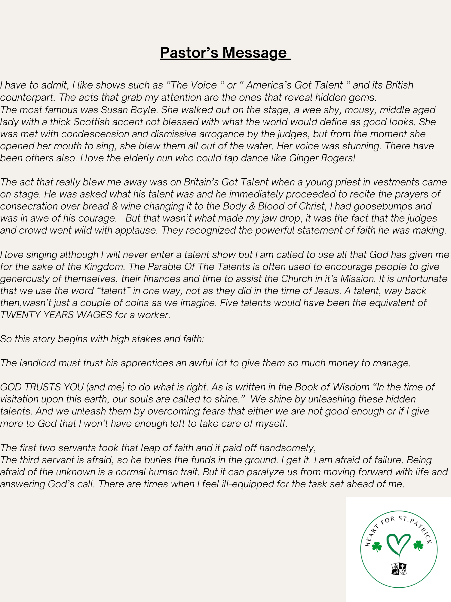
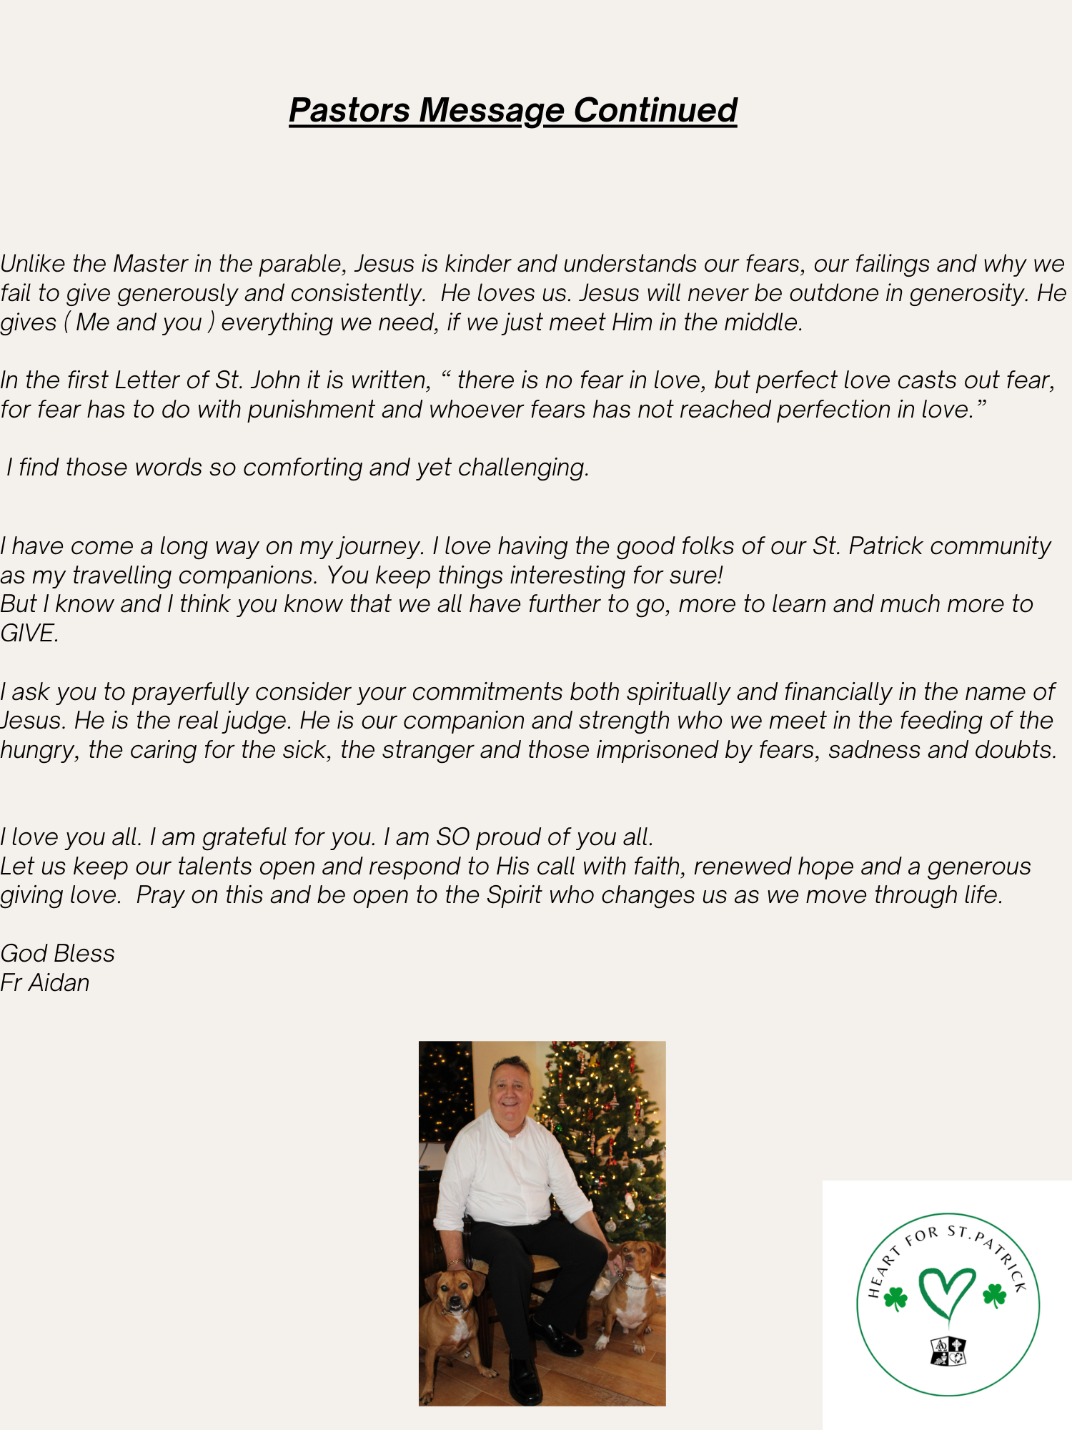

Slide 33
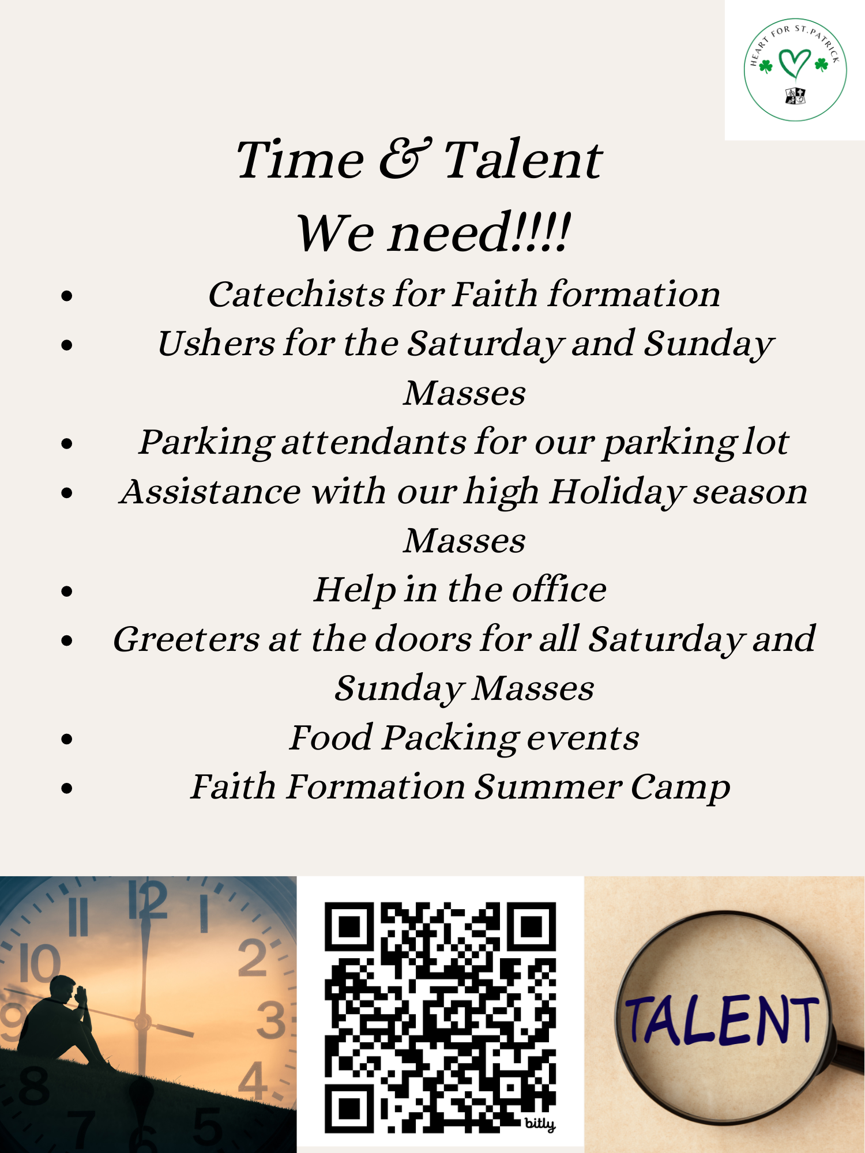
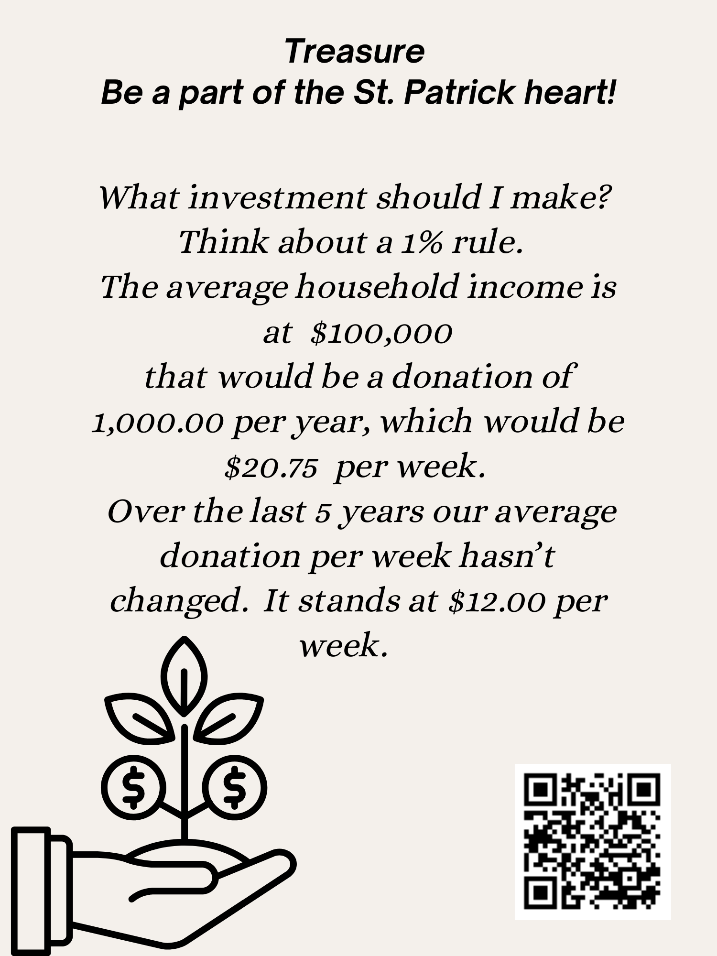
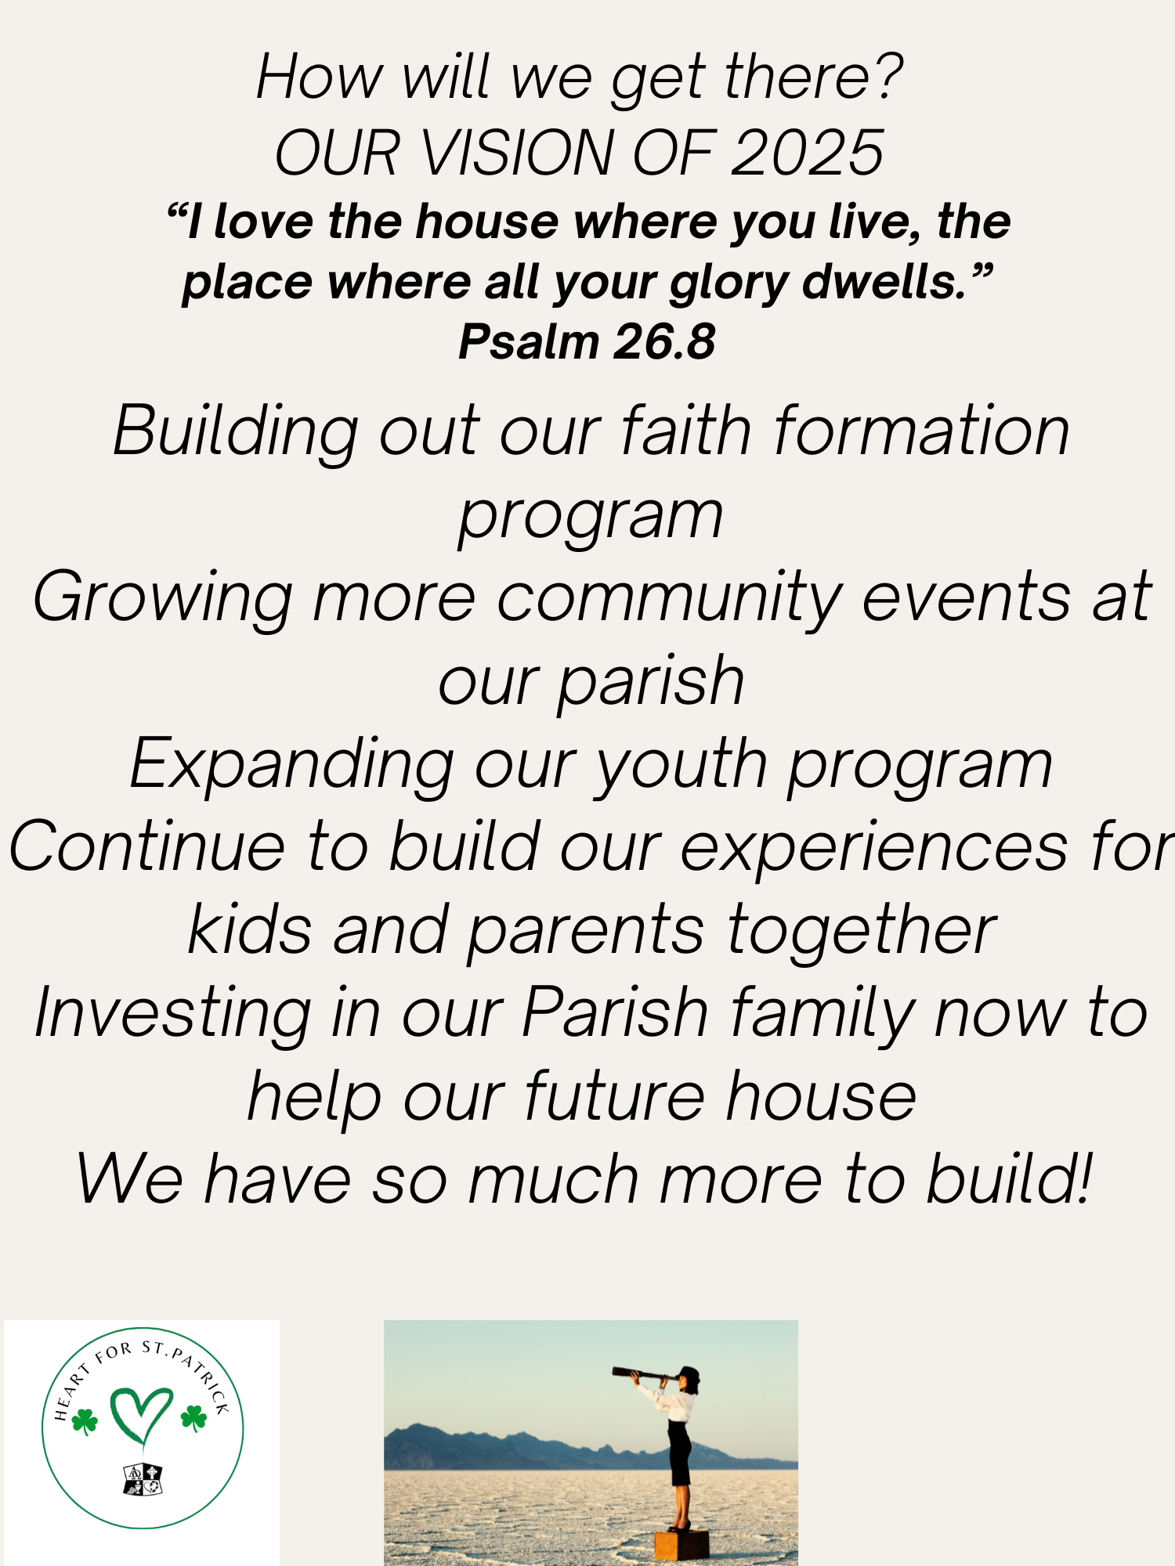

Slide 34
Bob and joan lapenna – st. Sebastian church
Funding is the first step in making a meal ministry
Volunteers: the backbone of every active ministry
Receiving donations & distribution

Slide 35

St. Sebastian Meal Ministry
Joan and bob Lapenna

Slide 36
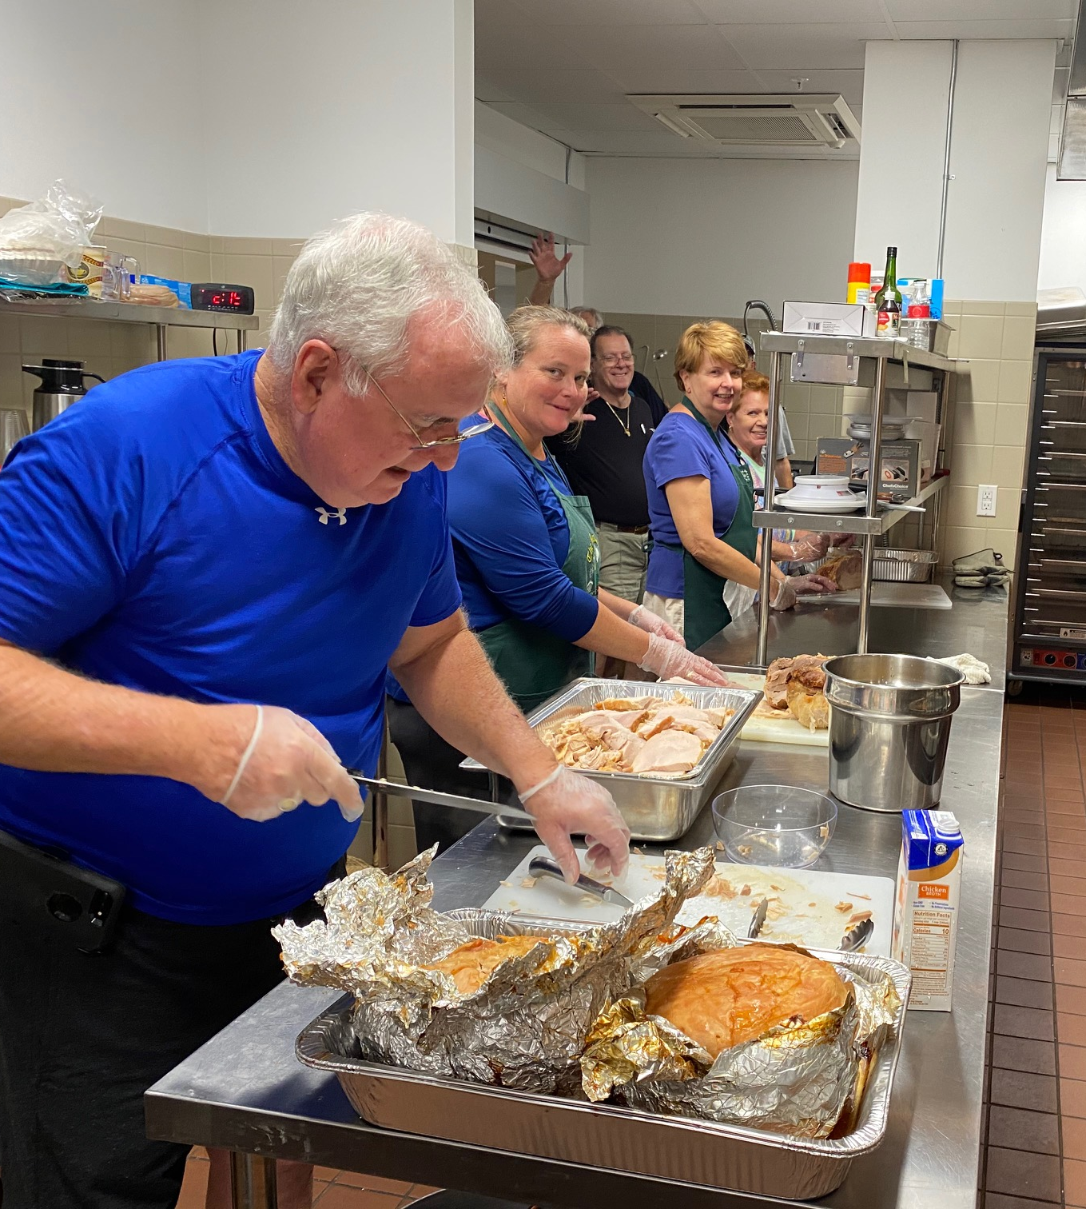
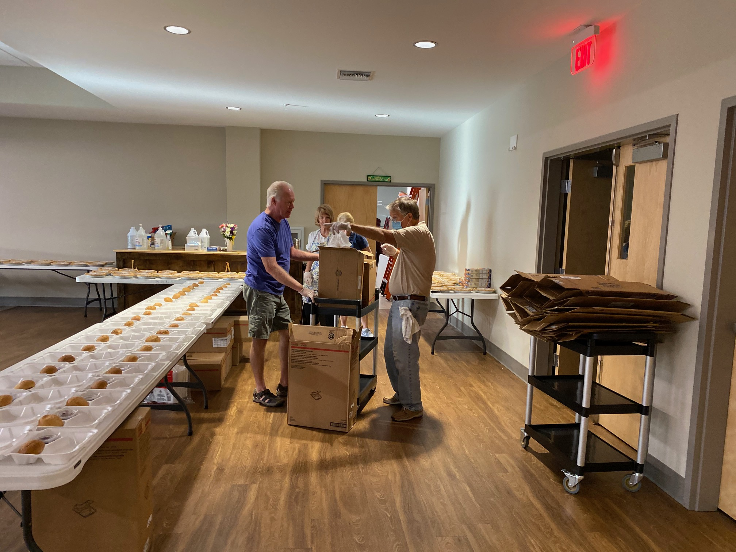
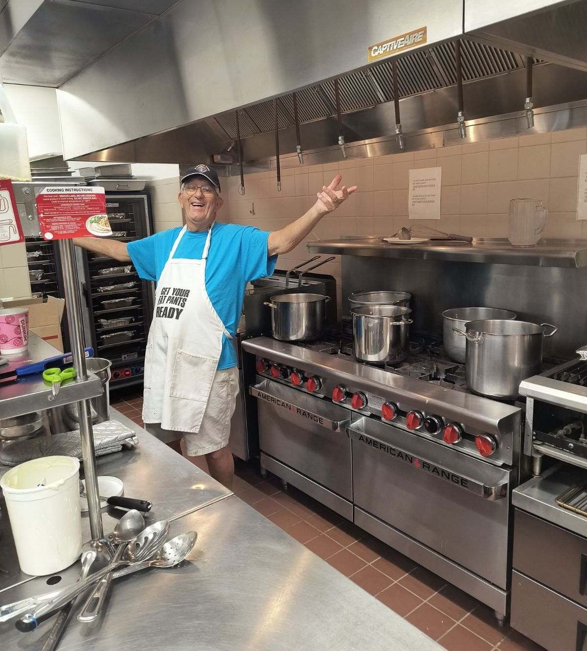
The Ministry

Slide 37
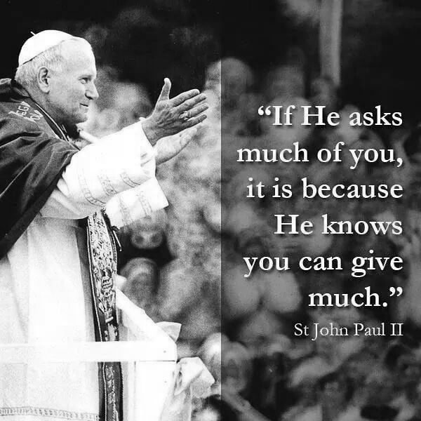
Conclusion
Thank you for attending
Next meeting date and topics?
Please complete survey before leaving
Amendment 4 and Faithful Citizenship

