Slide 1


Video Content Creation Workshop

Slide 2

Chapter 1: Storytelling and its Importance
If you’re looking to not only GET people’s attention,
but also KEEP their attention so you bring them into
your world and get the opportunity to convert them
into a subscriber or a customer for your business,
storytelling is one of the best ways to do it.
Show, Don’t Force – Show clients using your product or services and how it has made a difference in their world.
Use Open Loops - Open loops are how you make people curious and drag them into your story -- while they wait for the payoff you’ve promised to deliver.
Create a Brand Character - Building a brand personality or a brand character for your business is a great way to stand out.

Slide 3
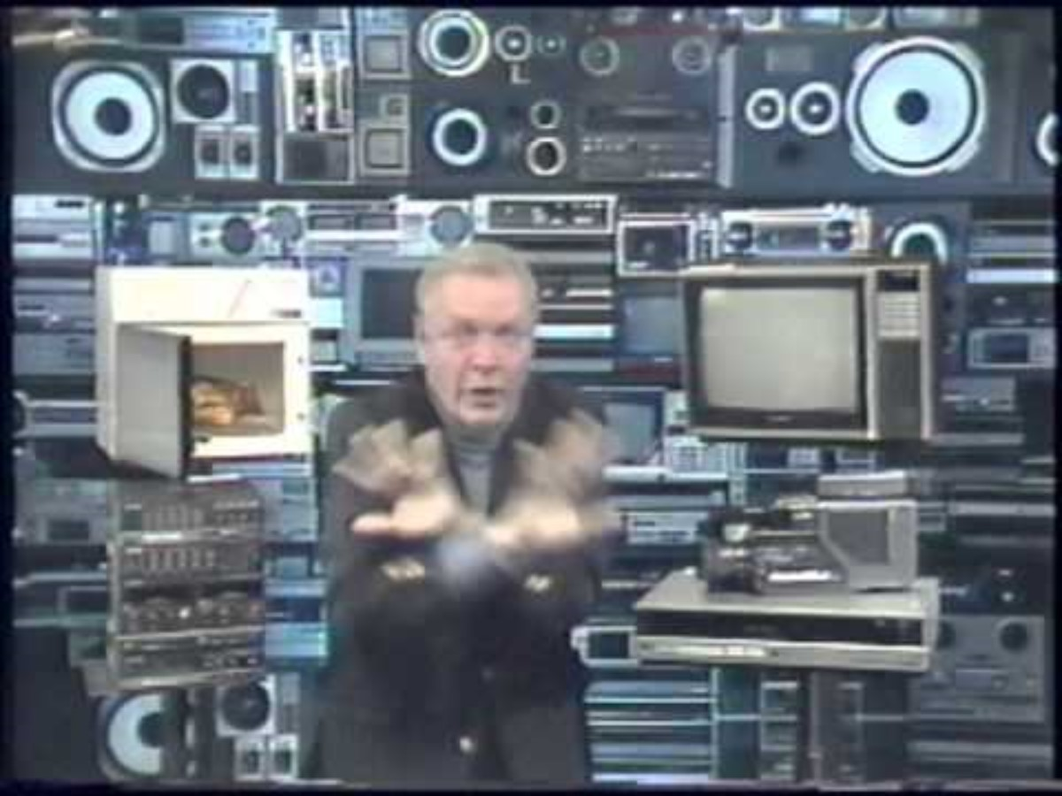
Chapter 1: Storytelling and its Importance
Show, Don’t Force
Show clients using your product or services and how |
it has made a difference in their world.

Slide 4
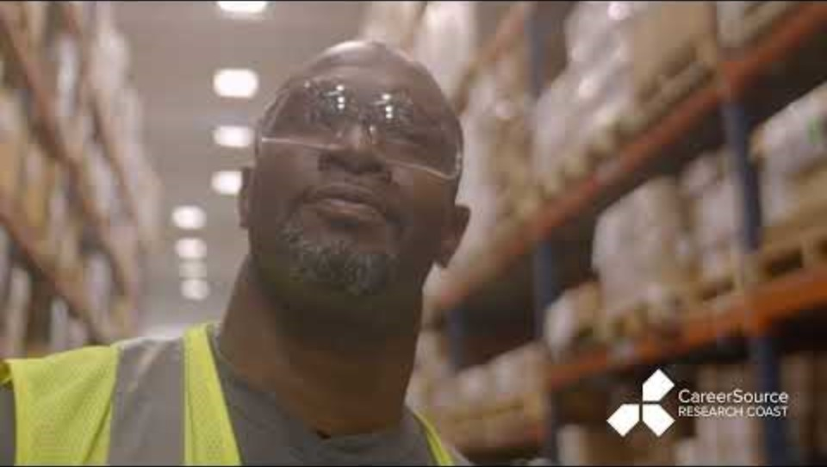
Chapter 1: Storytelling and its Importance
Show, Don’t Force
Show clients using your product or services and how |
it has made a difference in their world.

Slide 5
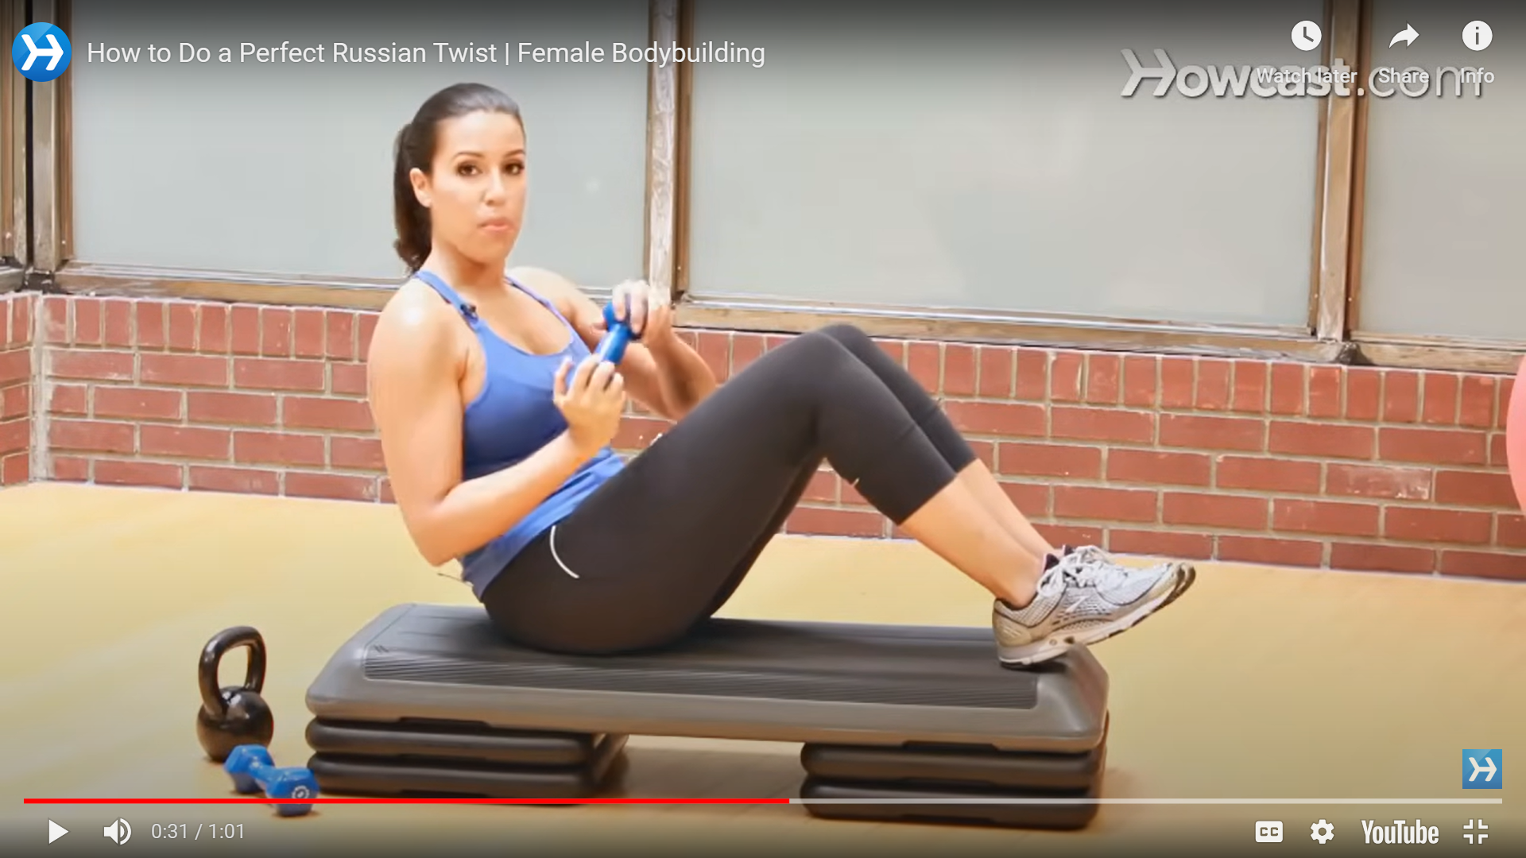
Chapter 1: Storytelling and its Importance
Use Open Loops
Open loops are how you make people curious and drag them into your story – while they wait for the payoff you’ve promised to deliver.
"By the end of this video, I will reveal the one food item that accelerated my weight loss journey."
Notes:
"By the end of this video, I will reveal the one food item that accelerated my weight loss journey."

Slide 6




Chapter 1: Storytelling and its Importance
Create a Brand Character
Building a brand personality or a brand character for your business is a great way to stand out.

Slide 7

Chapter 2: Storyboarding and Pre-Planning
Storyboarding is a critical step in the video production process as it helps you plan, visualize, and communicate the narrative and visual elements of your video effectively, ultimately leading to a more successful and cohesive product.

Slide 8
Chapter 2: Storyboarding and Pre-Planning

Slide 9
Chapter 2: Storyboarding and Pre-Planning

Slide 10
Chapter 3: Recording Your Video
Overview of equipment needed for video recording
Understanding camera settings: resolution, frame rate, etc.
Framing and composition techniques for effective storytelling
Lighting techniques for different moods and settings
Audio recording tips and best practices

Slide 11
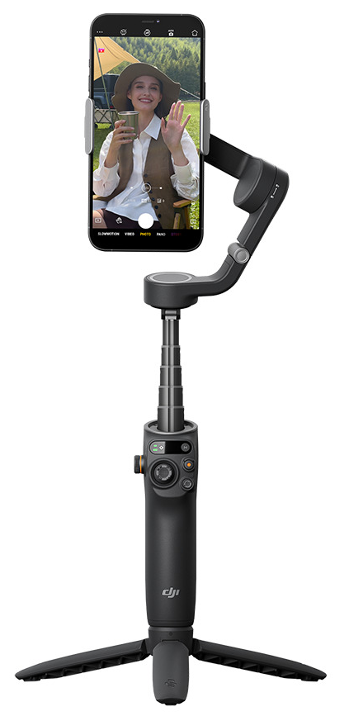
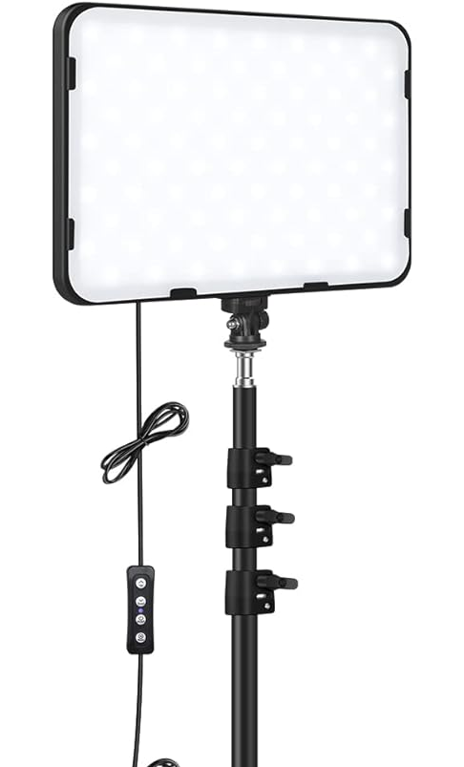
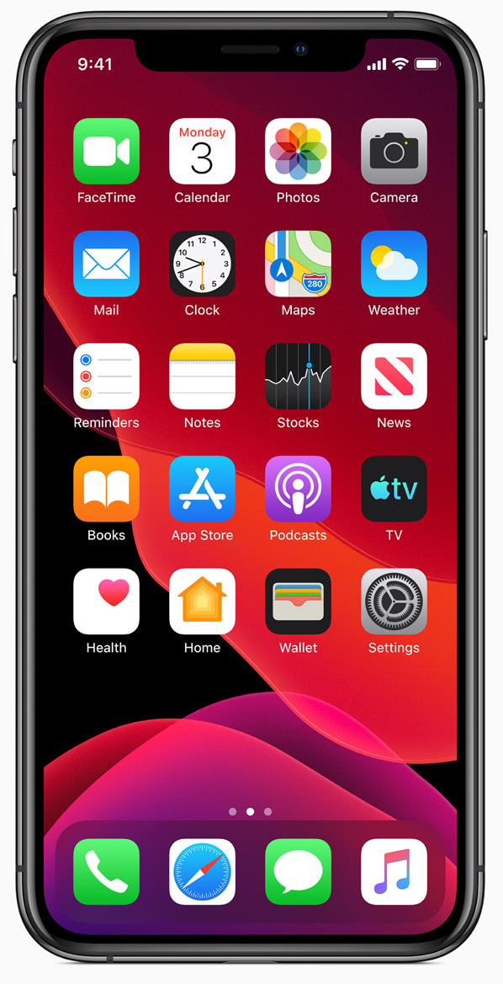
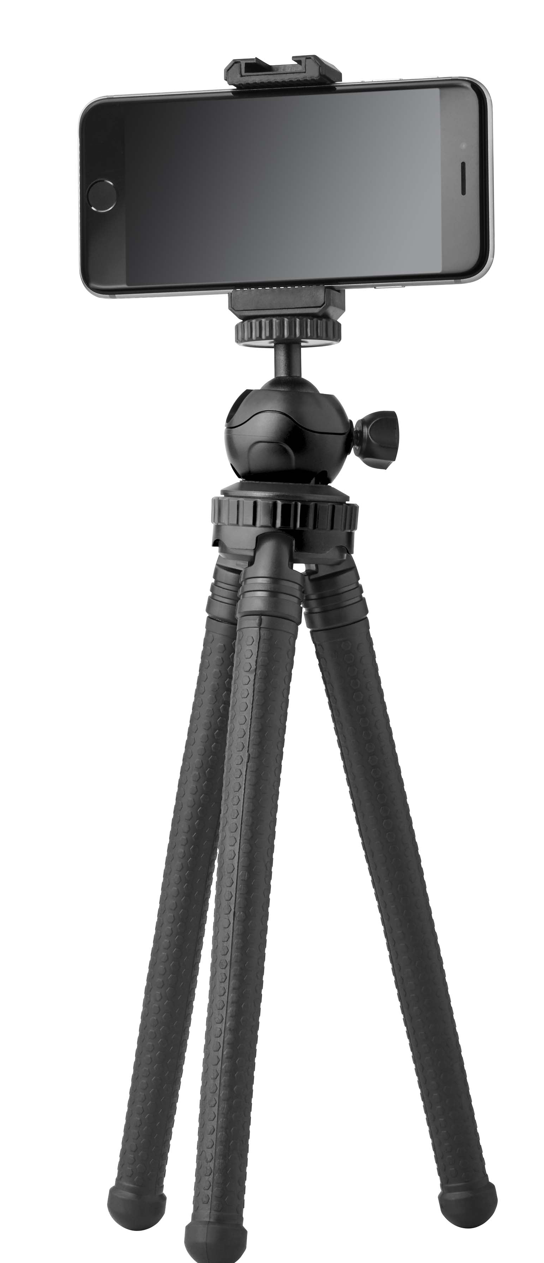
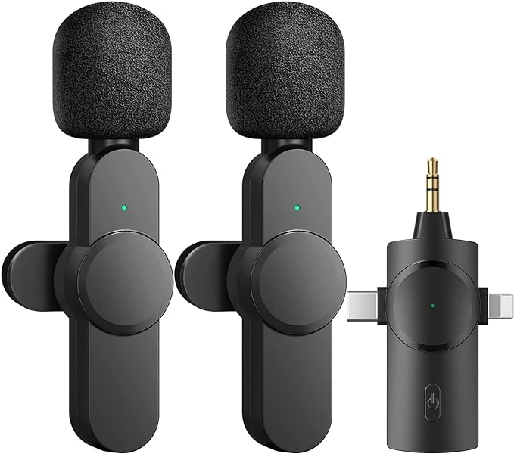
Chapter 3:
Recording Your Video

Slide 12

Chapter 3: Recording Your Video

Slide 13
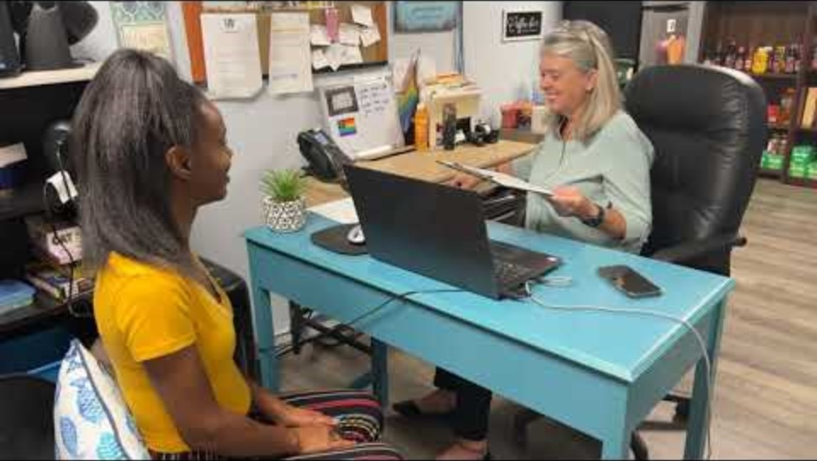
Chapter 3: Recording Your Video

Slide 14
Chapter 3: Recording Your Video
Reels vs Stories
Reels reach a wider audience which is what we want. Stories are more for your personal stuff meant for family/friends as they only go to your existing followers. You can also share a Reel to your Story.

Slide 15
Chapter 4: Editing
Introduction to video editing software
Importing and organizing footage
Basic editing techniques: cutting, trimming, transitions, etc.
Adding music, sound effects, and voiceovers
Color correction and grading for visual consistency
Exporting and sharing your final video

Slide 16
Chapter 3: Recording Your Video
K2 Photography & Marketing Video Workshop links
CapCut Video Editor: https://www.capcut.com
Wireless Microphone: https://a.co/d/bFgrxgJ
DJI Gimbal: https://a.co/d/5hkPVmA
LED Video Light Kit: https://a.co/d/6kuL0jI

Slide 17


Contact Us →
Mitch & Linda Kloorfain
k2photomarketing@gmail.com
www.k2photomarketing.com
This Powerpoint →

